Slide 1
This a test of your ability to efficiently shop for items on a grocery list
In the task that follows, you have two small shopping lists.
One is yours, and one is shopping you are doing for a friend.
Start at the top, near the entrance to the store (the green box near the Magazine area),
get all twelve items from the two lists, and
then go to the red box marked “To the Cashier”.
START HERE
TO THE CASHIER

Slide 2
Look for the shortest possible route
Your goal is to get all the items, as quickly and efficiently as you can.
This means you should try to take the shortest possible route.
Some of the items on the list are the only item you need from a particular area of the store. After you have found those single items, you need to return to the map to navigate to the next area, by clicking the blue “Return to map” button
Return to map

Slide 3
On the other hand, you do not need to return to the map in between each item if there is more than one item in a particular area.
When you navigate to a particular area of the store, you can click as many items as you need in that area.
Again, look for the shortest possible route.
If it would help you to remember which items you have found, you may use scratch paper to write down which objects you have found.

Slide 4
Getting oriented
On the next two screens, you will first see the grocery lists, and then the map.
After that, the lists will always be present on your screen, so you can use it to help remember what items to get.
TESTER: Please plug in your headphones now!

Slide 5
These are your shopping lists.
You do not need to remember them. You can see this list on every screen.
My list
Kraft 2% Sharp Cheddar Cheese
Organic Girl Baby Spring Mix Salad
Cascadian Farms Cinnamon Crunch Cereal
Silk Pure Almond Milk
Green Giant Cut Leaf Spinach
Campbell's Cream of Mushroom Soup
Friend’s list
Hillshire Farm Honey Ham
Post Shredded Wheat Cereal
Earthbound Farm Organic Spring Mix
Horizon DHA Omega 3 Whole Milk
Organic Girl I Love Baby Kale Salad
Kraft Deli Deluxe 2% American Cheese
Click here to see the map
Return to map

Slide 6
Click here to start the task
Fresh Bakery
Magazines
START HERE
The lists will reappear when you start the task
Fresh Fruit
Beer/Wine
Fresh Vegetables
Packaged Bread
Frozen Vegetables / Ice Cream
Potato Chips
Paper Towels / Toilet
Soda
Juice / Bottled Water
Pasta
Cereal
Facial Tissue
Vitamins
Mouthwash/ Dental
Candy / Cookies
Flour / Sugar
Rice / Condiments
Coffee
Household
Laundry Detergent
Canned Vegetables / Meats
Soups
Cheese / Milk / Sandwich Meats
TO THE CASHIER
Deli

Slide 7
My list
Kraft 2% Sharp Cheddar Cheese
Organic Girl Baby Spring Mix Salad
Cascadian Farms Cinnamon Crunch Cereal
Silk Pure Almond Milk
Green Giant Cut Leaf Spinach
Campbell's Cream of Mushroom Soup
Her list
Hillshire Farm Honey Ham
Post Shredded Wheat Cereal
Earthbound Farm Organic Spring Mix
Horizon DHA Omega 3 Whole Milk
Organic Girl I Love Baby Kale Salad
Kraft Deli Deluxe 2% American Cheese
Fresh Bakery
Magazines
START HERE
Fresh Fruit
Beer/Wine
Fresh Vegetables
Packaged Bread
Frozen Vegetables Ice Cream
Potato Chips
Paper Towels / Toilet
Soda
Juice / Bottled Water
Pasta
Cereal
Facial Tissue
Vitamins
Mouthwash/ Dental
Candy / Cookies
Flour / Sugar
Rice / Condiments
Coffee
Household
Laundry Detergent
Canned Vegetables Canned Meats
Soups
Cheese Milk Sandwich Meats
TO THE CASHIER
Deli
Click here to FINISH

Slide 8
Magazines
My list
Kraft 2% Sharp Cheddar Cheese
Organic Girl Baby Spring Mix Salad
Cascadian Farms Cinnamon Crunch Cereal
Silk Pure Almond Milk
Green Giant Cut Leaf Spinach
Campbell's Cream of Mushroom Soup
Her list
Hillshire Farm Honey Ham
Post Shredded Wheat Cereal
Earthbound Farm Organic Spring Mix
Horizon DHA Omega 3 Whole Milk
Organic Girl I Love Baby Kale Salad
Kraft Deli Deluxe 2% American Cheese
Return to map
There are no list items in this section
a

Slide 9
Bakery
My list
Kraft 2% Sharp Cheddar Cheese
Organic Girl Baby Spring Mix Salad
Cascadian Farms Cinnamon Crunch Cereal
Silk Pure Almond Milk
Green Giant Cut Leaf Spinach
Campbell's Cream of Mushroom Soup
Her list
Hillshire Farm Honey Ham
Post Shredded Wheat Cereal
Earthbound Farm Organic Spring Mix
Horizon DHA Omega 3 Whole Milk
Organic Girl I Love Baby Kale Salad
Kraft Deli Deluxe 2% American Cheese
Return t map
Return to map
There are no list items in this section
b

Slide 10
Fresh Fruit
My list
Kraft 2% Sharp Cheddar Cheese
Organic Girl Baby Spring Mix Salad
Cascadian Farms Cinnamon Crunch Cereal
Silk Pure Almond Milk
Green Giant Cut Leaf Spinach
Campbell's Cream of Mushroom Soup
Her list
Hillshire Farm Honey Ham
Post Shredded Wheat Cereal
Earthbound Farm Organic Spring Mix
Horizon DHA Omega 3 Whole Milk
Organic Girl I Love Baby Kale Salad
Kraft Deli Deluxe 2% American Cheese
Return to ap
Return to map
There are no list items in this section
c

Slide 11
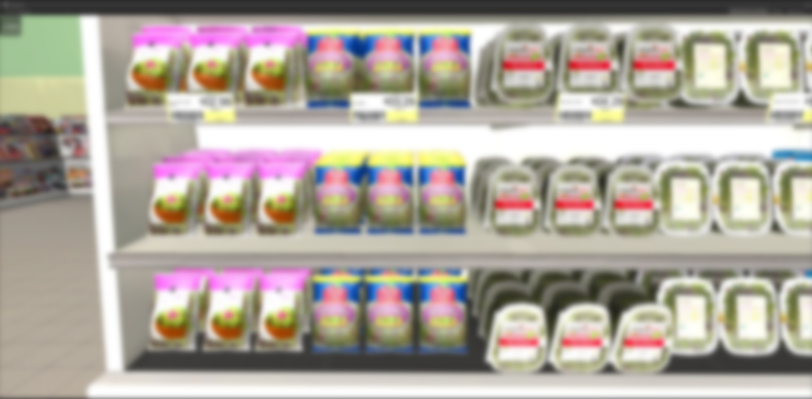
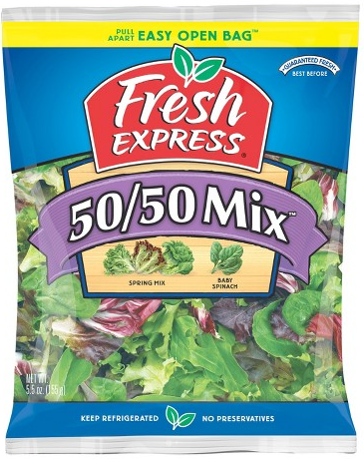
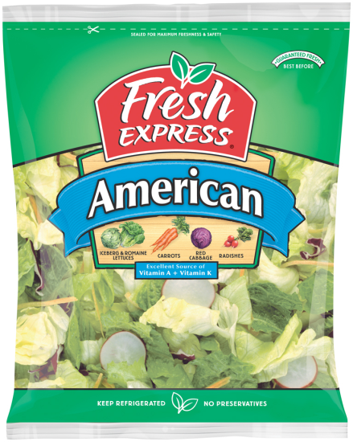
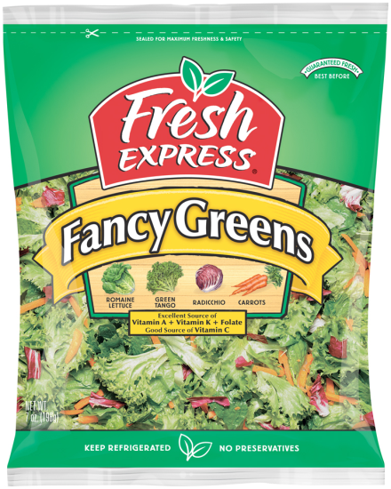
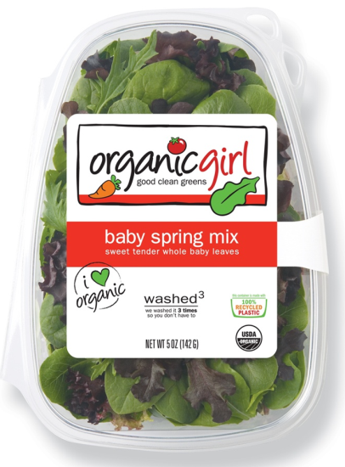
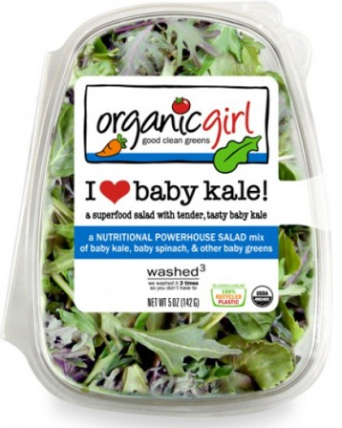
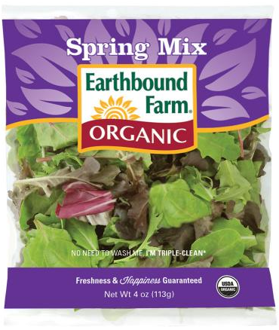
Fresh Vegetables
My list
Kraft 2% Sharp Cheddar Cheese
Organic Girl Baby Spring Mix Salad
Cascadian Farms Cinnamon Crunch Cereal
Silk Pure Almond Milk
Green Giant Cut Leaf Spinach
Campbell's Cream of Mushroom Soup
Her list
Hillshire Farm Honey Ham
Post Shredded Wheat Cereal
Earthbound Farm Organic Spring Mix
Horizon DHA Omega 3 Whole Milk
Organic Girl I Love Baby Kale Salad
Kraft Deli Deluxe 2% American Cheese
Return to ap
Return to map
d

Slide 12
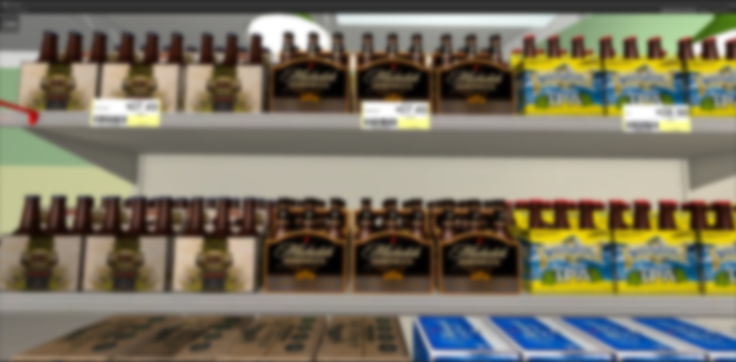
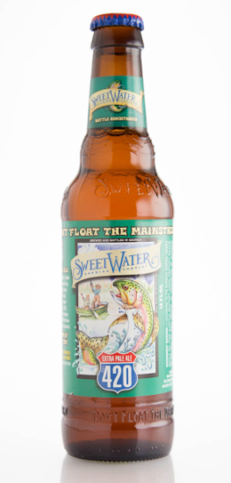
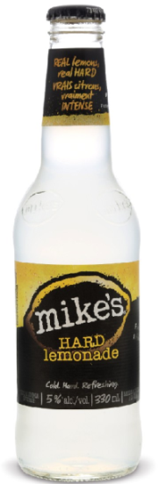
Beer/Wine
My list
Kraft 2% Sharp Cheddar Cheese
Organic Girl Baby Spring Mix Salad
Cascadian Farms Cinnamon Crunch Cereal
Silk Pure Almond Milk
Green Giant Cut Leaf Spinach
Campbell's Cream of Mushroom Soup
Her list
Hillshire Farm Honey Ham
Post Shredded Wheat Cereal
Earthbound Farm Organic Spring Mix
Horizon DHA Omega 3 Whole Milk
Organic Girl I Love Baby Kale Salad
Kraft Deli Deluxe 2% American Cheese
Return t map
Return to map
e

Slide 13
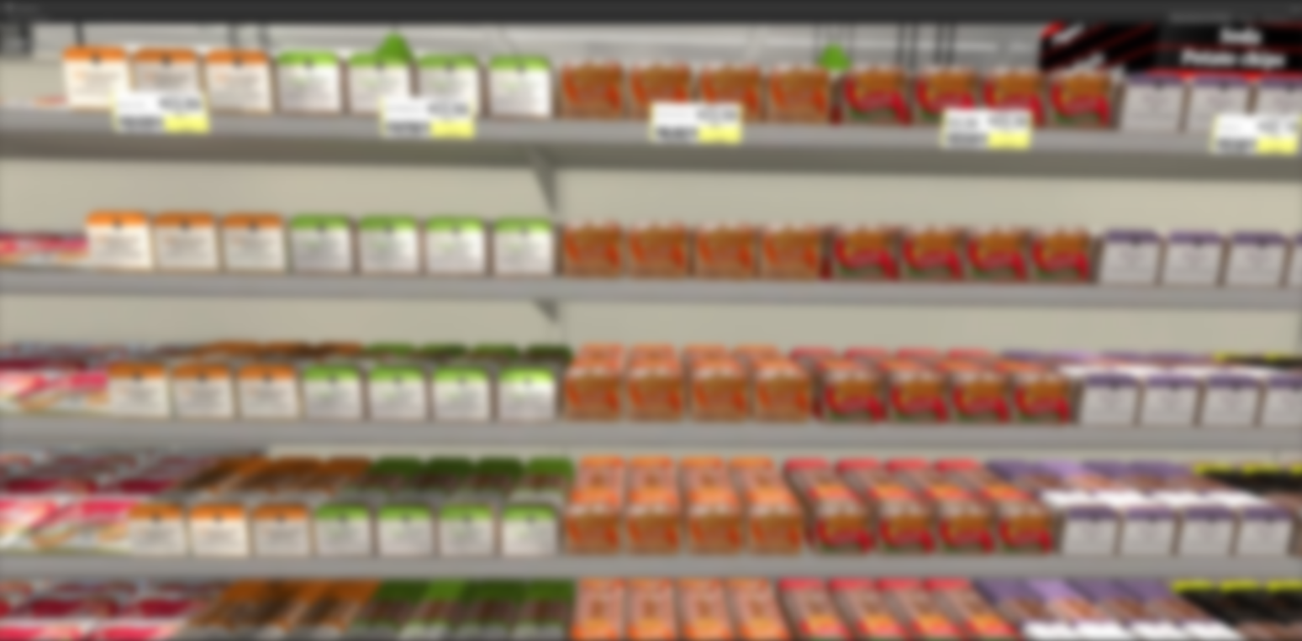
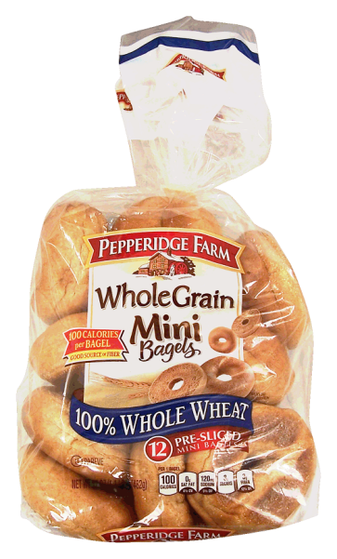
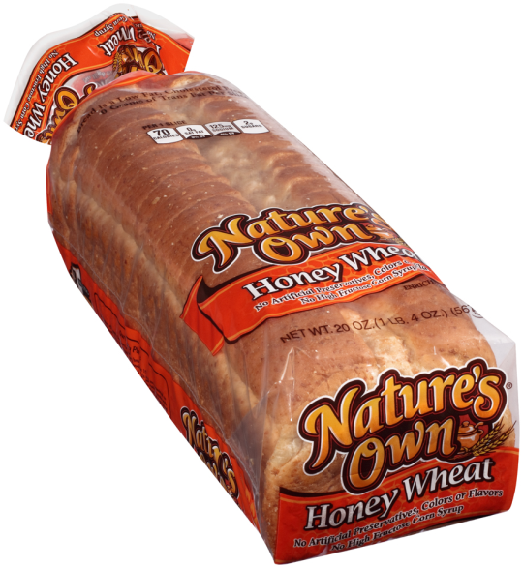
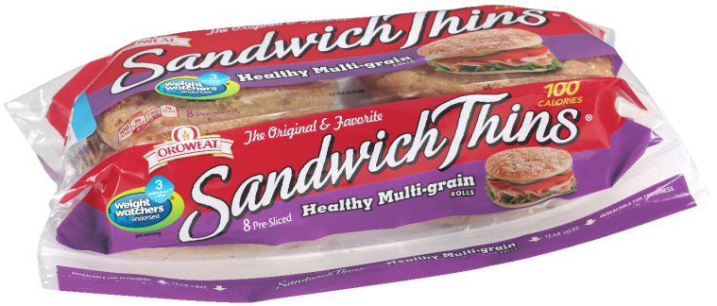
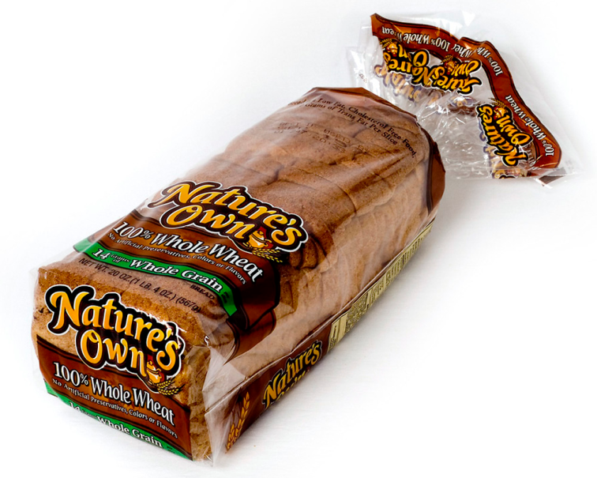
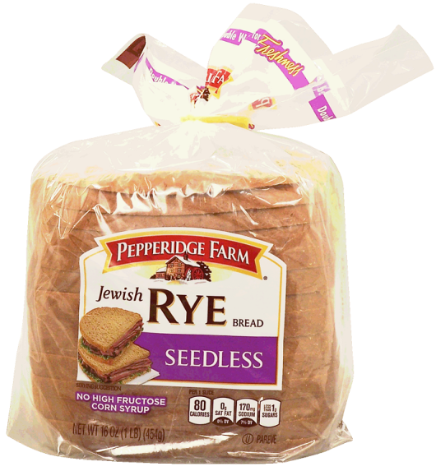
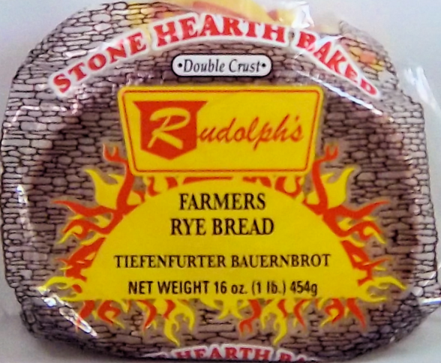
Packaged Bread
My list
Kraft 2% Sharp Cheddar Cheese
Organic Girl Baby Spring Mix Salad
Cascadian Farms Cinnamon Crunch Cereal
Silk Pure Almond Milk
Green Giant Cut Leaf Spinach
Campbell's Cream of Mushroom Soup
Her list
Hillshire Farm Honey Ham
Post Shredded Wheat Cereal
Earthbound Farm Organic Spring Mix
Horizon DHA Omega 3 Whole Milk
Organic Girl I Love Baby Kale Salad
Kraft Deli Deluxe 2% American Cheese
Return t map
Return to map
f

Slide 14
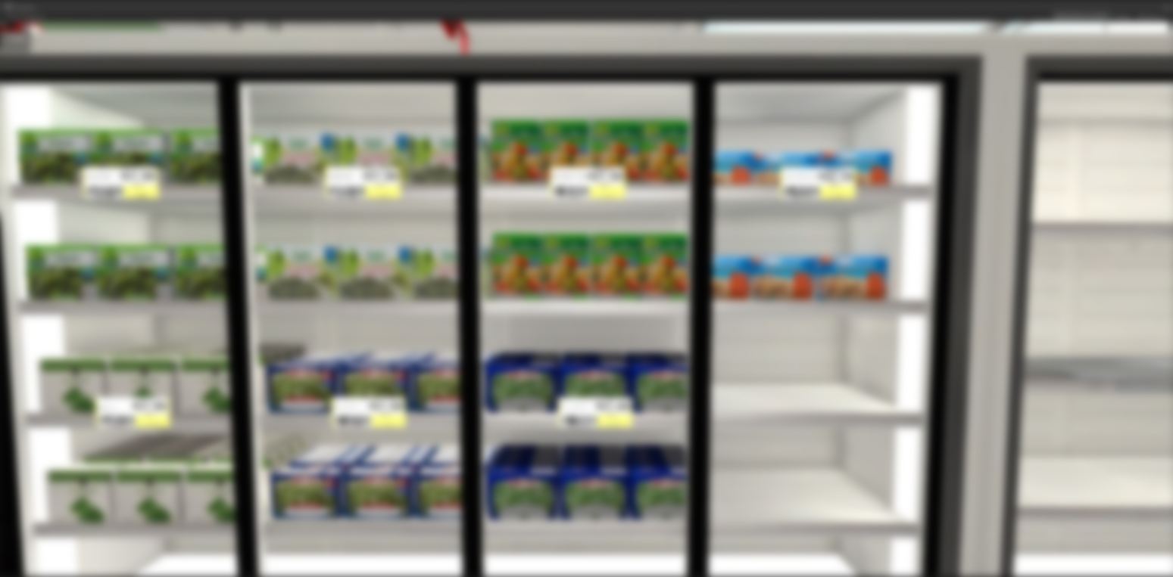
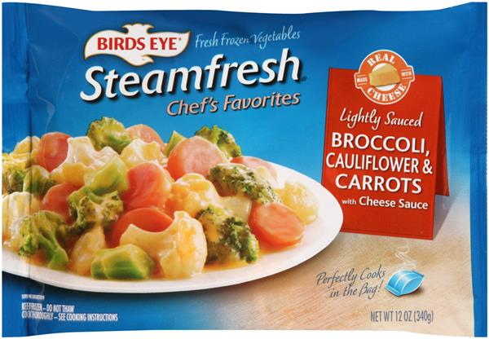
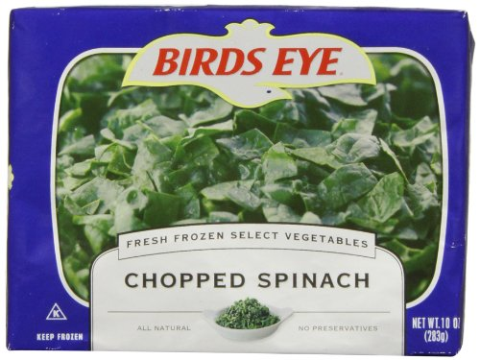
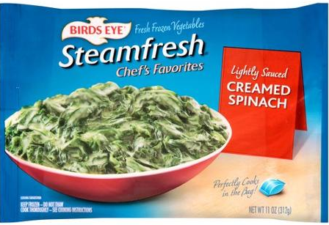
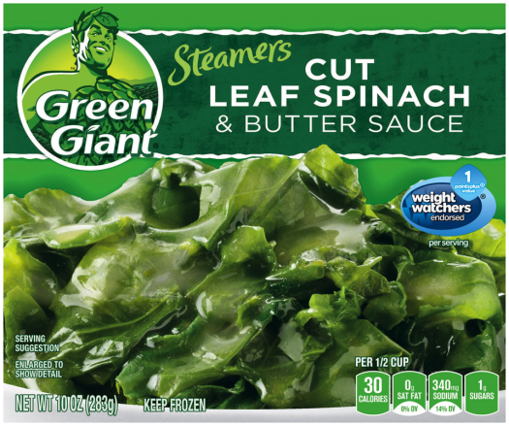
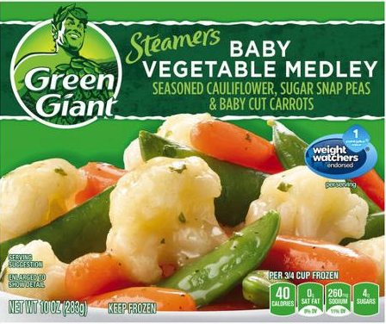
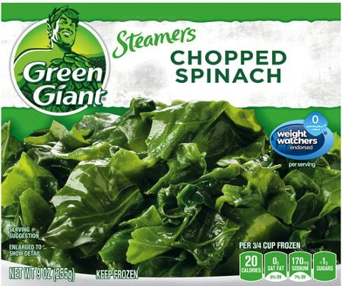
Frozen Vegetables
My list
Kraft 2% Sharp Cheddar Cheese
Organic Girl Baby Spring Mix Salad
Cascadian Farms Cinnamon Crunch Cereal
Silk Pure Almond Milk
Green Giant Cut Leaf Spinach
Campbell's Cream of Mushroom Soup
Her list
Hillshire Farm Honey Ham
Post Shredded Wheat Cereal
Earthbound Farm Organic Spring Mix
Horizon DHA Omega 3 Whole Milk
Organic Girl I Love Baby Kale Salad
Kraft Deli Deluxe 2% American Cheese
Return to map
g

Slide 15
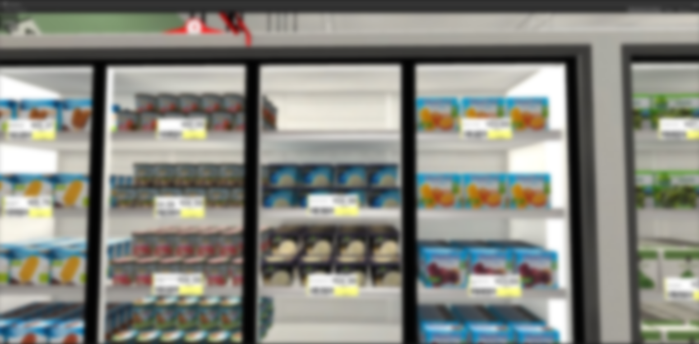
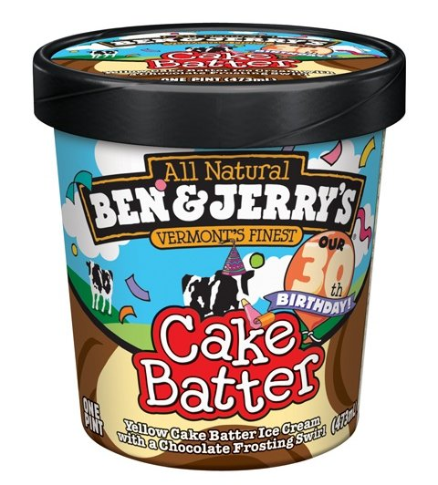
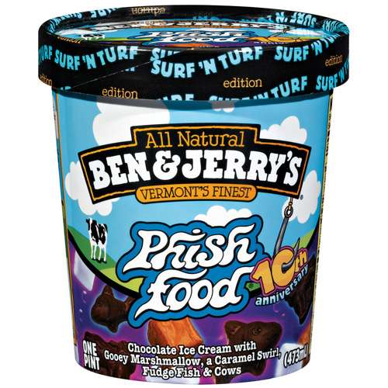
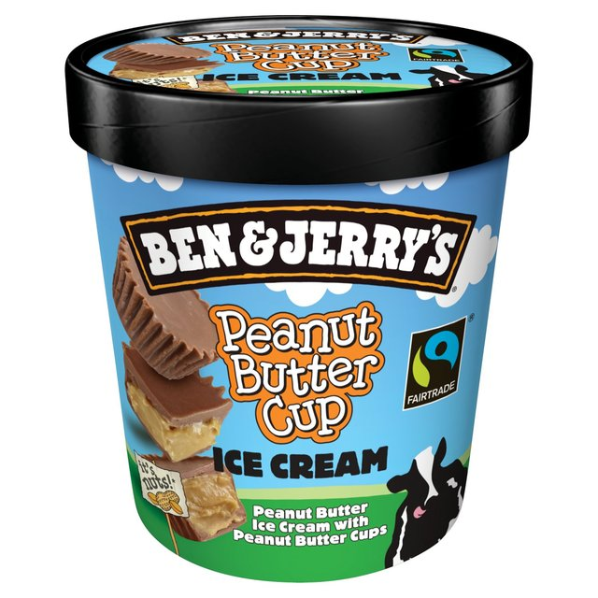
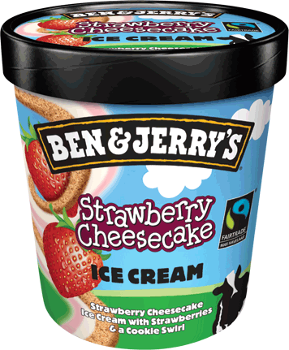
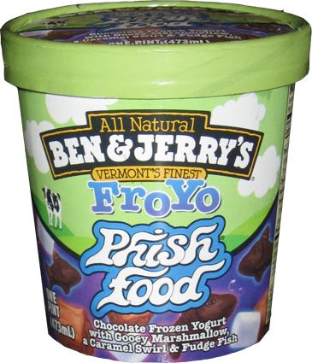
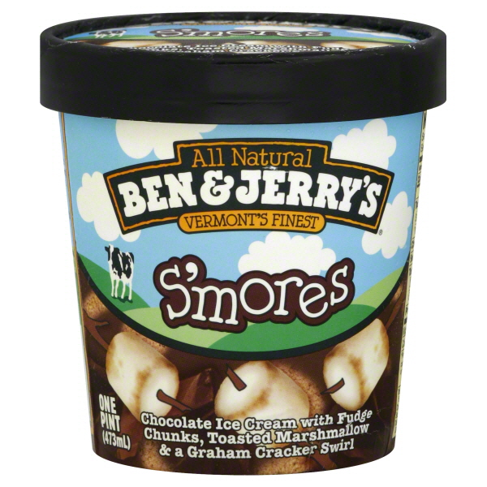
Ice Cream
My list
Kraft 2% Sharp Cheddar Cheese
Organic Girl Baby Spring Mix Salad
Cascadian Farms Cinnamon Crunch Cereal
Silk Pure Almond Milk
Green Giant Cut Leaf Spinach
Campbell's Cream of Mushroom Soup
Her list
Hillshire Farm Honey Ham
Post Shredded Wheat Cereal
Earthbound Farm Organic Spring Mix
Horizon DHA Omega 3 Whole Milk
Organic Girl I Love Baby Kale Salad
Kraft Deli Deluxe 2% American Cheese
Retun to map
Return to map
h

Slide 16
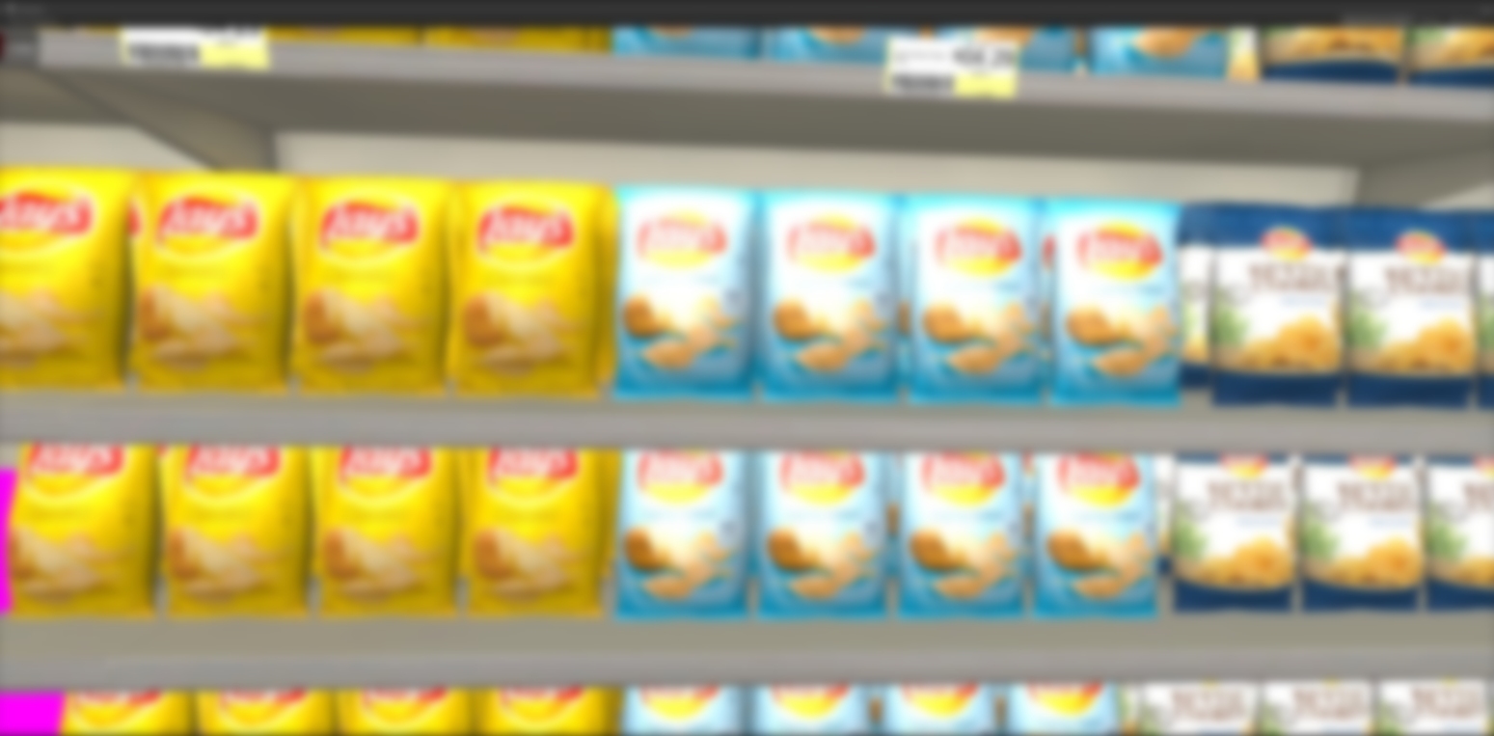
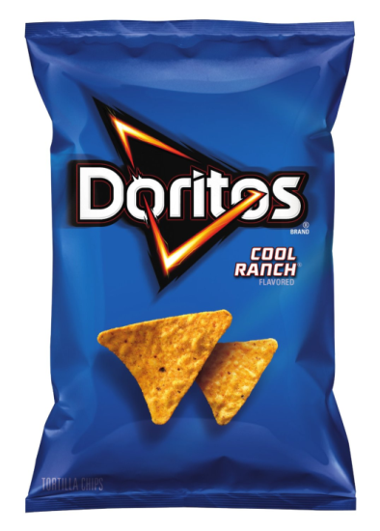
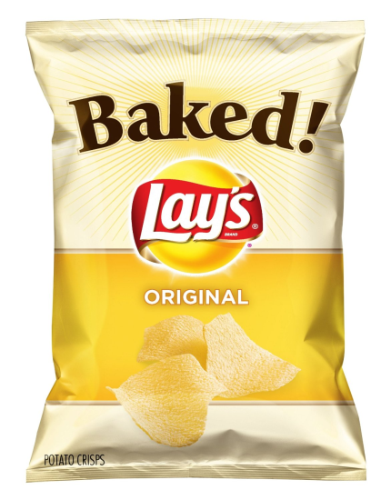
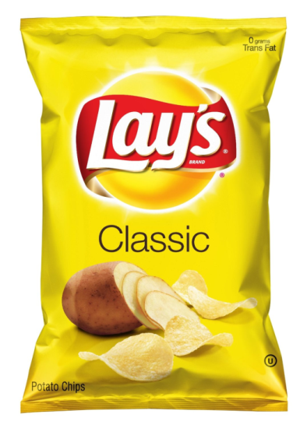
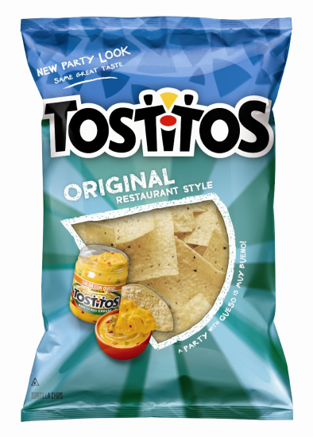
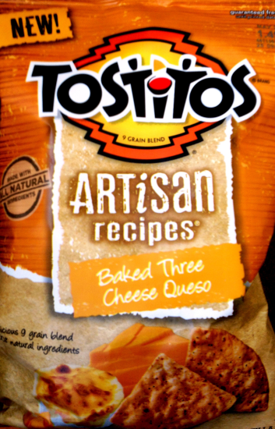
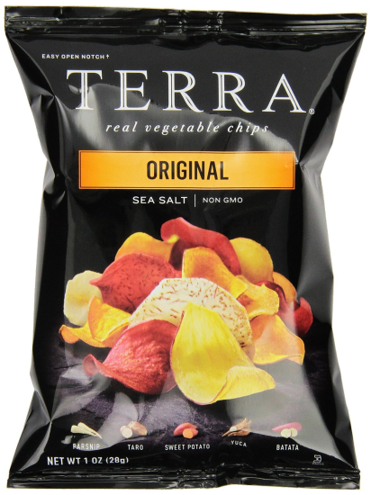
Potato Chips
My list
Kraft 2% Sharp Cheddar Cheese
Organic Girl Baby Spring Mix Salad
Cascadian Farms Cinnamon Crunch Cereal
Silk Pure Almond Milk
Green Giant Cut Leaf Spinach
Campbell's Cream of Mushroom Soup
Her list
Hillshire Farm Honey Ham
Post Shredded Wheat Cereal
Earthbound Farm Organic Spring Mix
Horizon DHA Omega 3 Whole Milk
Organic Girl I Love Baby Kale Salad
Kraft Deli Deluxe 2% American Cheese
Retrn to map
Return to map
i

Slide 17
Juice / Bottled Water
My list
Kraft 2% Sharp Cheddar Cheese
Organic Girl Baby Spring Mix Salad
Cascadian Farms Cinnamon Crunch Cereal
Silk Pure Almond Milk
Green Giant Cut Leaf Spinach
Campbell's Cream of Mushroom Soup
Her list
Hillshire Farm Honey Ham
Post Shredded Wheat Cereal
Earthbound Farm Organic Spring Mix
Horizon DHA Omega 3 Whole Milk
Organic Girl I Love Baby Kale Salad
Kraft Deli Deluxe 2% American Cheese
Retun to map
Return to map
There are no list items in this section
j

Slide 18
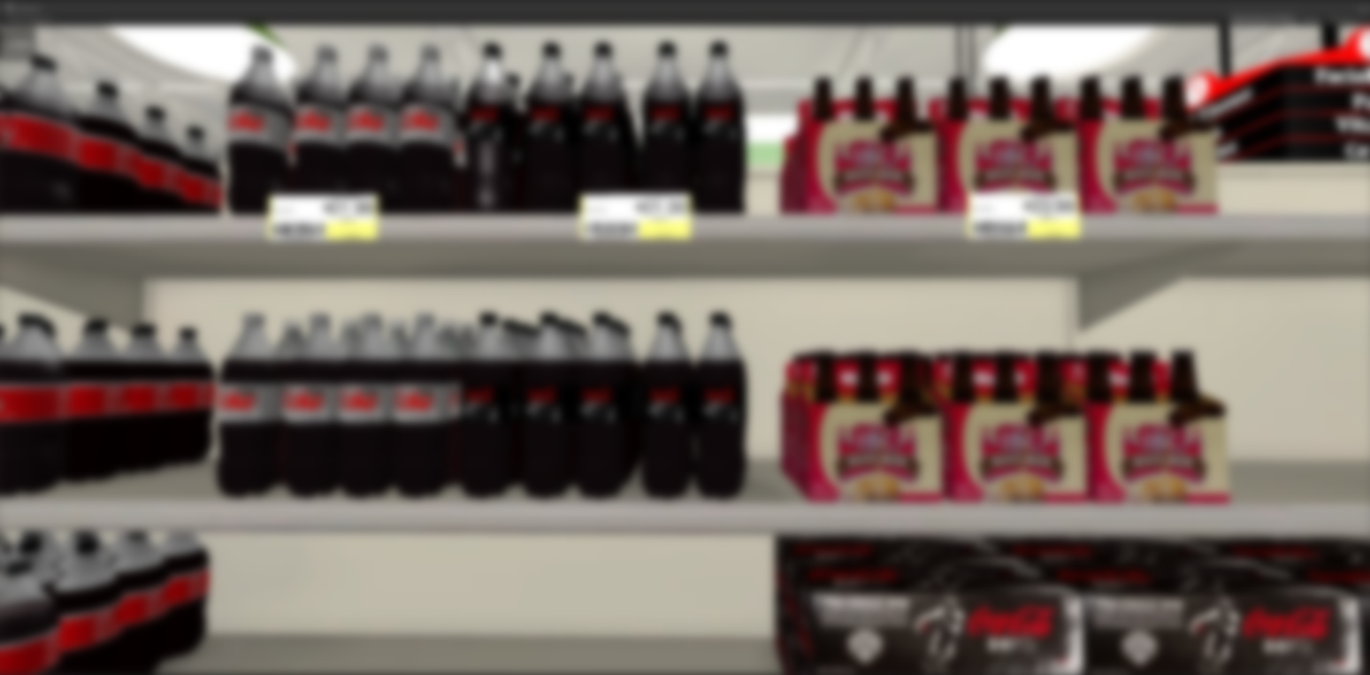
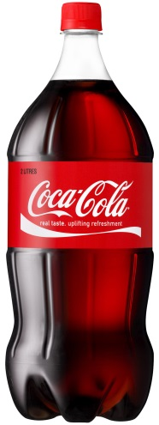
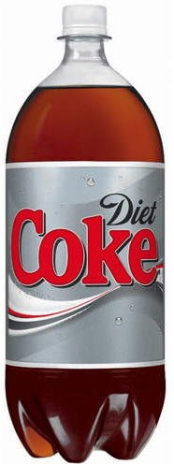
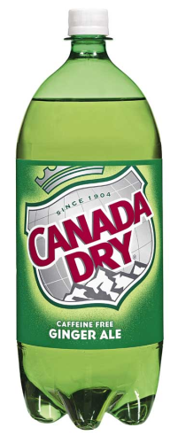
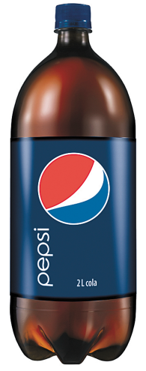
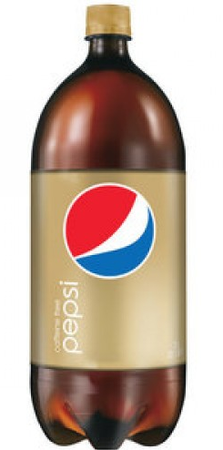
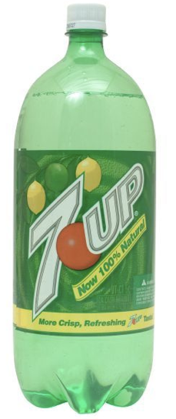
Soda
My list
Kraft 2% Sharp Cheddar Cheese
Organic Girl Baby Spring Mix Salad
Cascadian Farms Cinnamon Crunch Cereal
Silk Pure Almond Milk
Green Giant Cut Leaf Spinach
Campbell's Cream of Mushroom Soup
Her list
Hillshire Farm Honey Ham
Post Shredded Wheat Cereal
Earthbound Farm Organic Spring Mix
Horizon DHA Omega 3 Whole Milk
Organic Girl I Love Baby Kale Salad
Kraft Deli Deluxe 2% American Cheese
Retun to map
Return to map
k

Slide 19
Paper Towels / Toilet
My list
Kraft 2% Sharp Cheddar Cheese
Organic Girl Baby Spring Mix Salad
Cascadian Farms Cinnamon Crunch Cereal
Silk Pure Almond Milk
Green Giant Cut Leaf Spinach
Campbell's Cream of Mushroom Soup
Her list
Hillshire Farm Honey Ham
Post Shredded Wheat Cereal
Earthbound Farm Organic Spring Mix
Horizon DHA Omega 3 Whole Milk
Organic Girl I Love Baby Kale Salad
Kraft Deli Deluxe 2% American Cheese
Return t map
Return to map
There are no list items in this section
l

Slide 20
Pasta
My list
Kraft 2% Sharp Cheddar Cheese
Organic Girl Baby Spring Mix Salad
Cascadian Farms Cinnamon Crunch Cereal
Silk Pure Almond Milk
Green Giant Cut Leaf Spinach
Campbell's Cream of Mushroom Soup
Her list
Hillshire Farm Honey Ham
Post Shredded Wheat Cereal
Earthbound Farm Organic Spring Mix
Horizon DHA Omega 3 Whole Milk
Organic Girl I Love Baby Kale Salad
Kraft Deli Deluxe 2% American Cheese
Return to map
There are no list items in this section
m

Slide 21
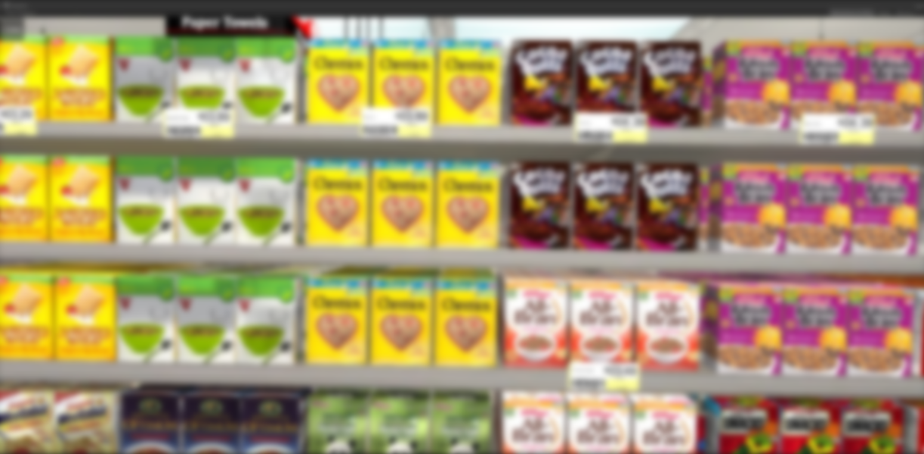
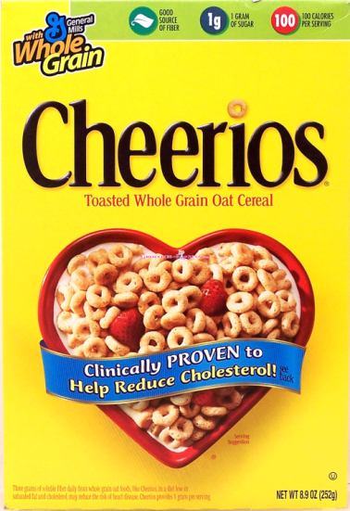
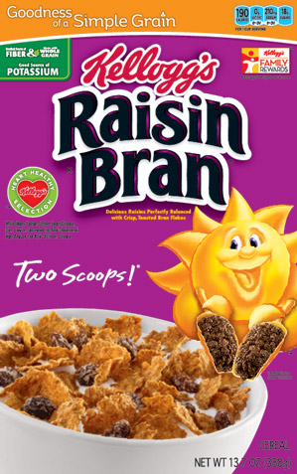
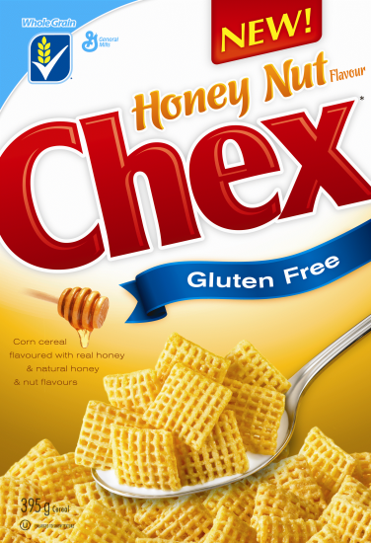
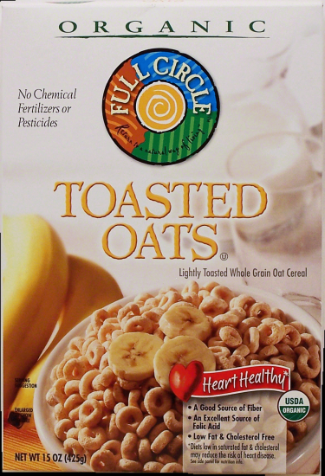
Cereal
My list
Kraft 2% Sharp Cheddar Cheese
Organic Girl Baby Spring Mix Salad
Cascadian Farms Cinnamon Crunch Cereal
Silk Pure Almond Milk
Green Giant Cut Leaf Spinach
Campbell's Cream of Mushroom Soup
Her list
Hillshire Farm Honey Ham
Post Shredded Wheat Cereal
Earthbound Farm Organic Spring Mix
Horizon DHA Omega 3 Whole Milk
Organic Girl I Love Baby Kale Salad
Kraft Deli Deluxe 2% American Cheese
Return to map
n

Slide 22
Mouthwash / Dental
My list
Kraft 2% Sharp Cheddar Cheese
Organic Girl Baby Spring Mix Salad
Cascadian Farms Cinnamon Crunch Cereal
Silk Pure Almond Milk
Green Giant Cut Leaf Spinach
Campbell's Cream of Mushroom Soup
Her list
Hillshire Farm Honey Ham
Post Shredded Wheat Cereal
Earthbound Farm Organic Spring Mix
Horizon DHA Omega 3 Whole Milk
Organic Girl I Love Baby Kale Salad
Kraft Deli Deluxe 2% American Cheese
Return to map
There are no list items in this section
o

Slide 23
Vitamins
My list
Kraft 2% Sharp Cheddar Cheese
Organic Girl Baby Spring Mix Salad
Cascadian Farms Cinnamon Crunch Cereal
Silk Pure Almond Milk
Green Giant Cut Leaf Spinach
Campbell's Cream of Mushroom Soup
Her list
Hillshire Farm Honey Ham
Post Shredded Wheat Cereal
Earthbound Farm Organic Spring Mix
Horizon DHA Omega 3 Whole Milk
Organic Girl I Love Baby Kale Salad
Kraft Deli Deluxe 2% American Cheese
Return to map
p

Slide 24
Facial Tissue
My list
Kraft 2% Sharp Cheddar Cheese
Organic Girl Baby Spring Mix Salad
Cascadian Farms Cinnamon Crunch Cereal
Silk Pure Almond Milk
Green Giant Cut Leaf Spinach
Campbell's Cream of Mushroom Soup
Her list
Hillshire Farm Honey Ham
Post Shredded Wheat Cereal
Earthbound Farm Organic Spring Mix
Horizon DHA Omega 3 Whole Milk
Organic Girl I Love Baby Kale Salad
Kraft Deli Deluxe 2% American Cheese
Return to map
There are no list items in this section
q

Slide 25
Candy / Cookies
My list
Kraft 2% Sharp Cheddar Cheese
Organic Girl Baby Spring Mix Salad
Cascadian Farms Cinnamon Crunch Cereal
Silk Pure Almond Milk
Green Giant Cut Leaf Spinach
Campbell's Cream of Mushroom Soup
Her list
Hillshire Farm Honey Ham
Post Shredded Wheat Cereal
Earthbound Farm Organic Spring Mix
Horizon DHA Omega 3 Whole Milk
Organic Girl I Love Baby Kale Salad
Kraft Deli Deluxe 2% American Cheese
Return to map
There are no list items in this section
r

Slide 26
Flour / Sugar
My list
Kraft 2% Sharp Cheddar Cheese
Organic Girl Baby Spring Mix Salad
Cascadian Farms Cinnamon Crunch Cereal
Silk Pure Almond Milk
Green Giant Cut Leaf Spinach
Campbell's Cream of Mushroom Soup
Her list
Hillshire Farm Honey Ham
Post Shredded Wheat Cereal
Earthbound Farm Organic Spring Mix
Horizon DHA Omega 3 Whole Milk
Organic Girl I Love Baby Kale Salad
Kraft Deli Deluxe 2% American Cheese
Return to map
There are no list items in this section
s

Slide 27
Rice / Condiments
My list
Kraft 2% Sharp Cheddar Cheese
Organic Girl Baby Spring Mix Salad
Cascadian Farms Cinnamon Crunch Cereal
Silk Pure Almond Milk
Green Giant Cut Leaf Spinach
Campbell's Cream of Mushroom Soup
Her list
Hillshire Farm Honey Ham
Post Shredded Wheat Cereal
Earthbound Farm Organic Spring Mix
Horizon DHA Omega 3 Whole Milk
Organic Girl I Love Baby Kale Salad
Kraft Deli Deluxe 2% American Cheese
Return to map
There are no list items in this section
t

Slide 28
Laundry Detergent
My list
Kraft 2% Sharp Cheddar Cheese
Organic Girl Baby Spring Mix Salad
Cascadian Farms Cinnamon Crunch Cereal
Silk Pure Almond Milk
Green Giant Cut Leaf Spinach
Campbell's Cream of Mushroom Soup
Her list
Hillshire Farm Honey Ham
Post Shredded Wheat Cereal
Earthbound Farm Organic Spring Mix
Horizon DHA Omega 3 Whole Milk
Organic Girl I Love Baby Kale Salad
Kraft Deli Deluxe 2% American Cheese
Return to map
There are no list items in this section
u

Slide 29
Household
My list
Kraft 2% Sharp Cheddar Cheese
Organic Girl Baby Spring Mix Salad
Cascadian Farms Cinnamon Crunch Cereal
Silk Pure Almond Milk
Green Giant Cut Leaf Spinach
Campbell's Cream of Mushroom Soup
Her list
Hillshire Farm Honey Ham
Post Shredded Wheat Cereal
Earthbound Farm Organic Spring Mix
Horizon DHA Omega 3 Whole Milk
Organic Girl I Love Baby Kale Salad
Kraft Deli Deluxe 2% American Cheese
Return to map
There are no list items in this section
v

Slide 30
Coffee
My list
Kraft 2% Sharp Cheddar Cheese
Organic Girl Baby Spring Mix Salad
Cascadian Farms Cinnamon Crunch Cereal
Silk Pure Almond Milk
Green Giant Cut Leaf Spinach
Campbell's Cream of Mushroom Soup
Her list
Hillshire Farm Honey Ham
Post Shredded Wheat Cereal
Earthbound Farm Organic Spring Mix
Horizon DHA Omega 3 Whole Milk
Organic Girl I Love Baby Kale Salad
Kraft Deli Deluxe 2% American Cheese
Return to map
There are no list items in this section
w

Slide 31
Canned Vegetables
My list
Kraft 2% Sharp Cheddar Cheese
Organic Girl Baby Spring Mix Salad
Cascadian Farms Cinnamon Crunch Cereal
Silk Pure Almond Milk
Green Giant Cut Leaf Spinach
Campbell's Cream of Mushroom Soup
Her list
Hillshire Farm Honey Ham
Post Shredded Wheat Cereal
Earthbound Farm Organic Spring Mix
Horizon DHA Omega 3 Whole Milk
Organic Girl I Love Baby Kale Salad
Kraft Deli Deluxe 2% American Cheese
Return to map
x

Slide 32
Canned Meats
My list
Kraft 2% Sharp Cheddar Cheese
Organic Girl Baby Spring Mix Salad
Cascadian Farms Cinnamon Crunch Cereal
Silk Pure Almond Milk
Green Giant Cut Leaf Spinach
Campbell's Cream of Mushroom Soup
Her list
Hillshire Farm Honey Ham
Post Shredded Wheat Cereal
Earthbound Farm Organic Spring Mix
Horizon DHA Omega 3 Whole Milk
Organic Girl I Love Baby Kale Salad
Kraft Deli Deluxe 2% American Cheese
Return to map
There are no list items in this section
y

Slide 33
Soup
My list
Kraft 2% Sharp Cheddar Cheese
Organic Girl Baby Spring Mix Salad
Cascadian Farms Cinnamon Crunch Cereal
Silk Pure Almond Milk
Green Giant Cut Leaf Spinach
Campbell's Cream of Mushroom Soup
Her list
Hillshire Farm Honey Ham
Post Shredded Wheat Cereal
Earthbound Farm Organic Spring Mix
Horizon DHA Omega 3 Whole Milk
Organic Girl I Love Baby Kale Salad
Kraft Deli Deluxe 2% American Cheese
Return to map
z

Slide 34
Cheese
My list
Kraft 2% Sharp Cheddar Cheese
Organic Girl Baby Spring Mix Salad
Cascadian Farms Cinnamon Crunch Cereal
Silk Pure Almond Milk
Green Giant Cut Leaf Spinach
Campbell's Cream of Mushroom Soup
Her list
Hillshire Farm Honey Ham
Post Shredded Wheat Cereal
Earthbound Farm Organic Spring Mix
Horizon DHA Omega 3 Whole Milk
Organic Girl I Love Baby Kale Salad
Kraft Deli Deluxe 2% American Cheese
Return to map
aa

Slide 35
Milk
My list
Kraft 2% Sharp Cheddar Cheese
Organic Girl Baby Spring Mix Salad
Cascadian Farms Cinnamon Crunch Cereal
Silk Pure Almond Milk
Green Giant Cut Leaf Spinach
Campbell's Cream of Mushroom Soup
Her list
Hillshire Farm Honey Ham
Post Shredded Wheat Cereal
Earthbound Farm Organic Spring Mix
Horizon DHA Omega 3 Whole Milk
Organic Girl I Love Baby Kale Salad
Kraft Deli Deluxe 2% American Cheese
Return to map
ab

Slide 36
Sandwich Meats
My list
Kraft 2% Sharp Cheddar Cheese
Organic Girl Baby Spring Mix Salad
Cascadian Farms Cinnamon Crunch Cereal
Silk Pure Almond Milk
Green Giant Cut Leaf Spinach
Campbell's Cream of Mushroom Soup
Her list
Hillshire Farm Honey Ham
Post Shredded Wheat Cereal
Earthbound Farm Organic Spring Mix
Horizon DHA Omega 3 Whole Milk
Organic Girl I Love Baby Kale Salad
Kraft Deli Deluxe 2% American Cheese
Return to map
ac

Slide 37
Deli
My list
Kraft 2% Sharp Cheddar Cheese
Organic Girl Baby Spring Mix Salad
Cascadian Farms Cinnamon Crunch Cereal
Silk Pure Almond Milk
Green Giant Cut Leaf Spinach
Campbell's Cream of Mushroom Soup
Her list
Hillshire Farm Honey Ham
Post Shredded Wheat Cereal
Earthbound Farm Organic Spring Mix
Horizon DHA Omega 3 Whole Milk
Organic Girl I Love Baby Kale Salad
Kraft Deli Deluxe 2% American Cheese
Return to map
There are no list items in this section
ad

Slide 38
Thank you! This concludes the test.

