Slide 1
This is a test of your ability to identify and compare ingredients and nutrition information
On the screens that follow, you will see common grocery items
For each screen, you will be asked a question about the nutritional information regarding the item or items
Click the correct answer at the bottom of the screen
Try to respond as quickly and accurately as you can

Slide 2
Tester: Plug your headphones in before the slide advances If you are ready to begin finding and comparing ingredients, click here

Slide 3
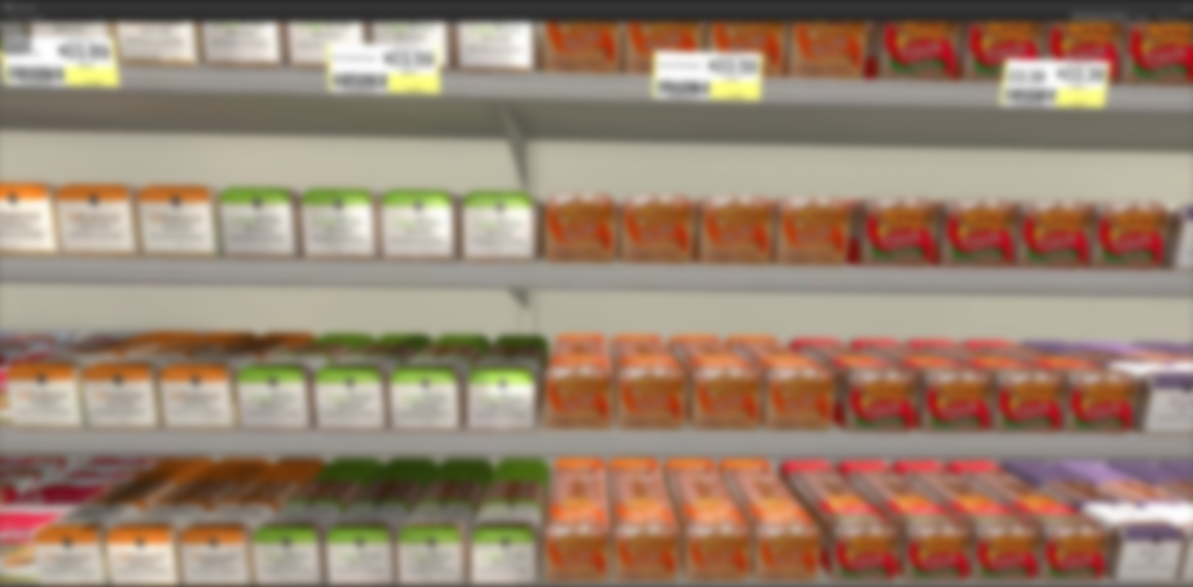
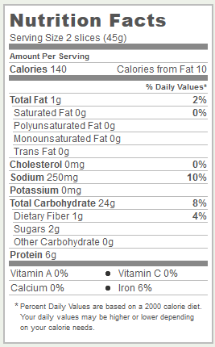
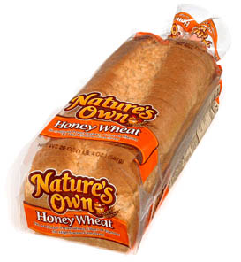
How much dietary fiber does Nature’s Own Honey Wheat bread have per serving?
a. 0 grams
b. 1 gram
c. 24 grams

Slide 4
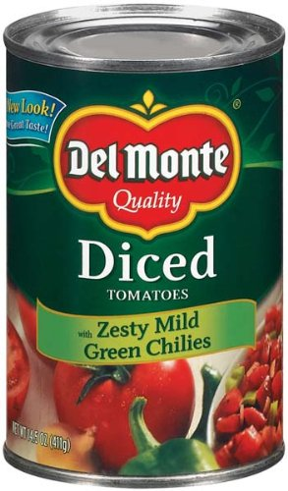
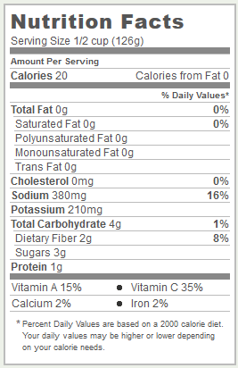
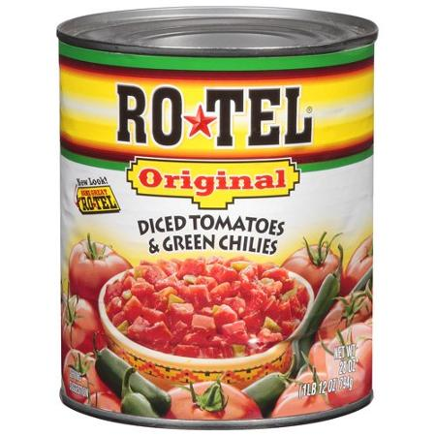
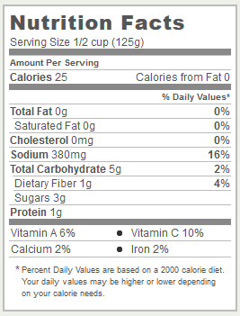
Which of these two food items is higher in calories per serving?
a. Del Monte Diced Tomatoes
b. Rotel Diced Tomatoes

Slide 5
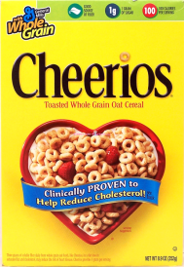
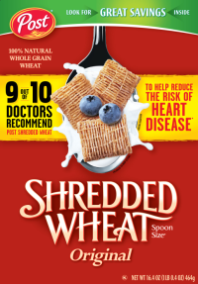
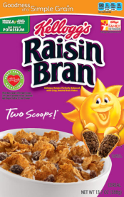
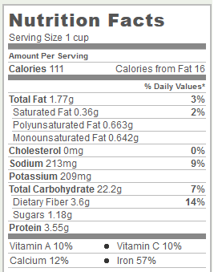
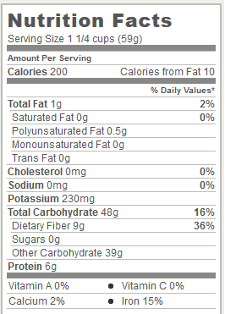
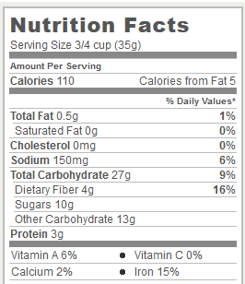
Which of these three food items is highest in protein per serving?
a. Cheerios
b. Shredded Wheat
c. Raisin Bran

Slide 6
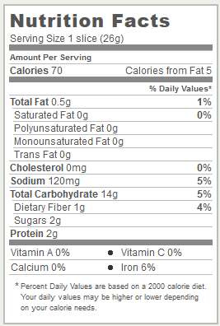
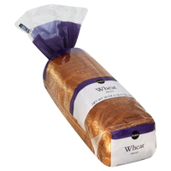
How much fat and sugar does Publix Wheat bread have per serving?
a. 0.5 fat/0 sugar
b. 0 fat/2 sugar
c. 0.5 fat/2 sugar

Slide 7
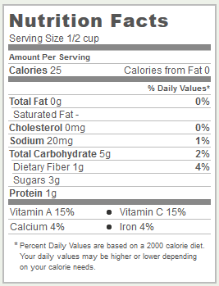
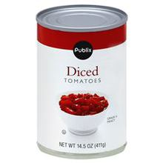
Which food item would you pick if you wanted the one that was higher in Vitamin A and Vitamin C, per serving?
a. Rotel Diced Tomatoes
b. Publix Diced Tomatoes

Slide 8
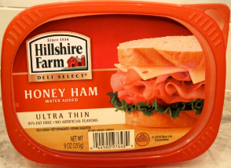
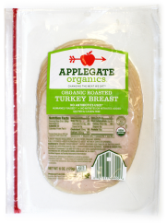
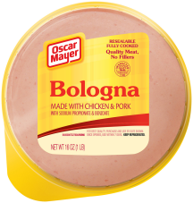
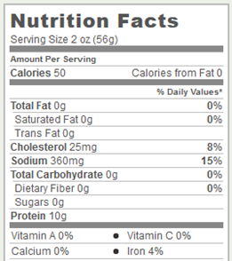
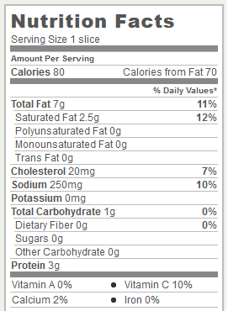
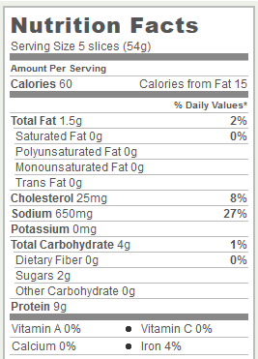
Which food item would you pick if you wanted the one that was lowest in saturated fat and sugar but highest in protein, per serving?
a. Applegate Organic Roasted Turkey
b. Oscar Meyer Bologna
c. Hillshire Farm Honey Ham

Slide 9
Thank you! This concludes the test.

