Slide 1
Tester: Plug your headphones in before the slide advances Remember those grocery items I asked you to remember and find three times before? Now, I want you to remember and find them one last time. If you are ready to begin finding, click here

Slide 2
Fresh Bakery
Magazines
Fresh Fruit
Beer/Wine
Fresh Vegetables
Packaged Bread
Frozen Vegetables Ice Cream
Potato Chips
Paper Towels / Toilet
Soda
Juice / Bottled Water
Pasta
Cereal
Facial Tissue
Vitamins
Mouthwash/ Dental
Candy / Cookies
Flour / Sugar
Rice / Condiments
Coffee
Household
Laundry Detergent
Canned Vegetables Canned Meats
Soups
Cheese Milk Sandwich Meats
Deli
If you are finished, click here

Slide 3
Magazines
Return to map
There are no list items in this section
a

Slide 4
Bakery
Return to map
There are no list items in this section
b

Slide 5
Fresh Fruit
Return to map
There are no list items in this section
c

Slide 6
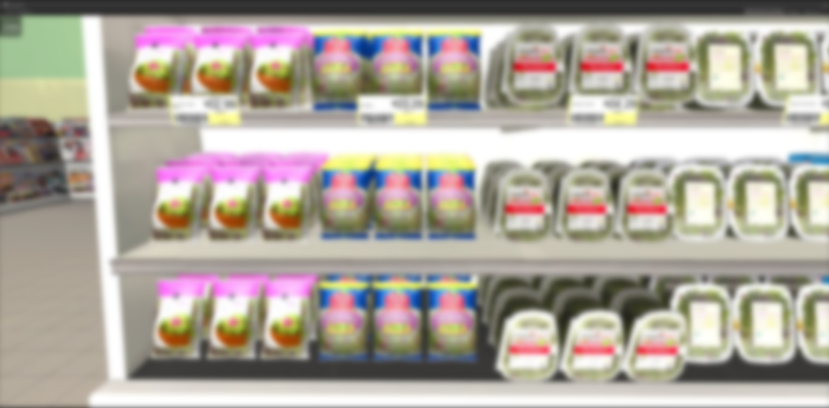
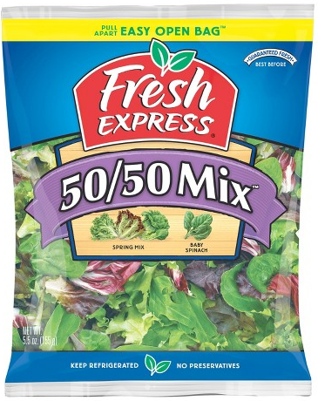
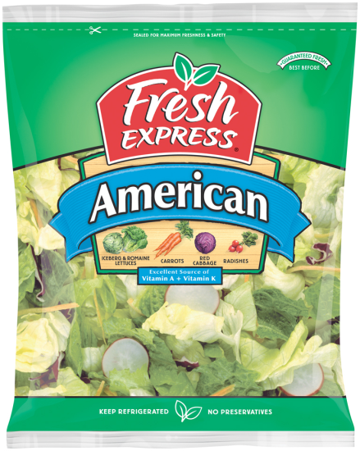
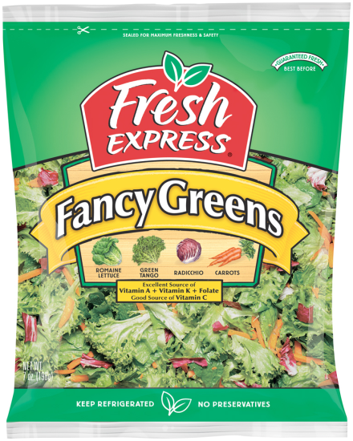
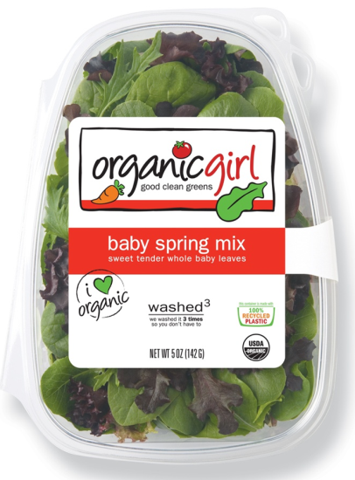
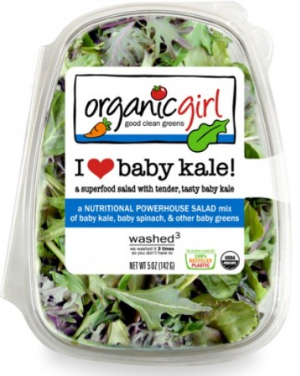
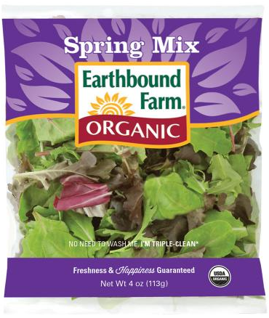
Fresh Vegetables
Return to map
d

Slide 7
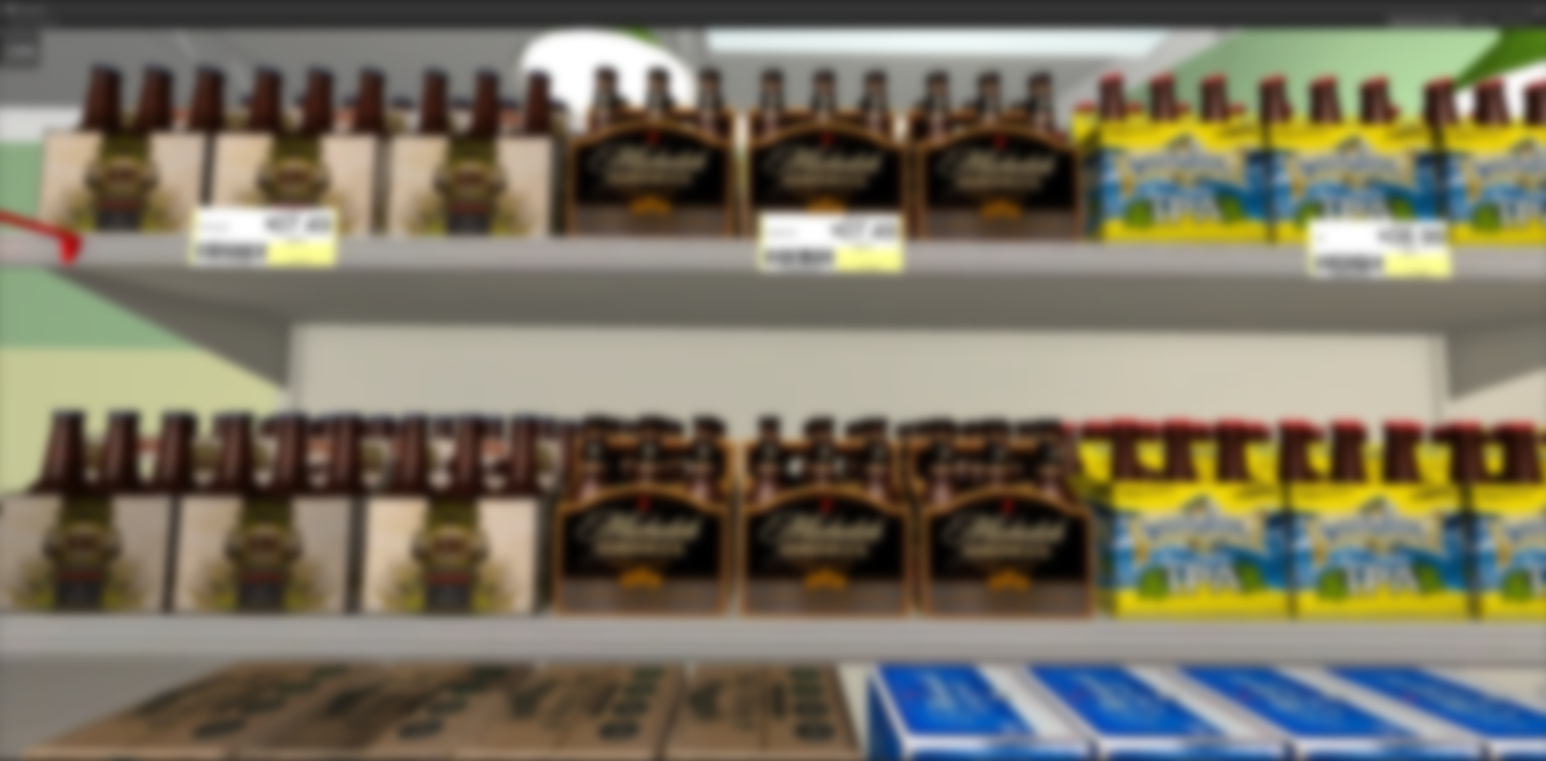
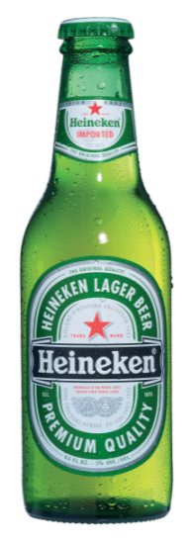
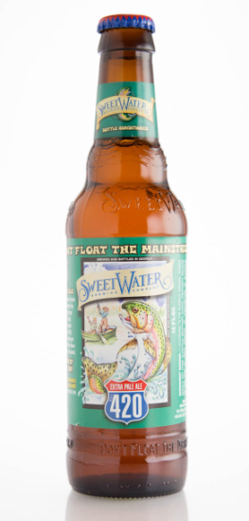
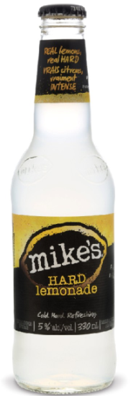
Beer/Wine
Return to map
e

Slide 8
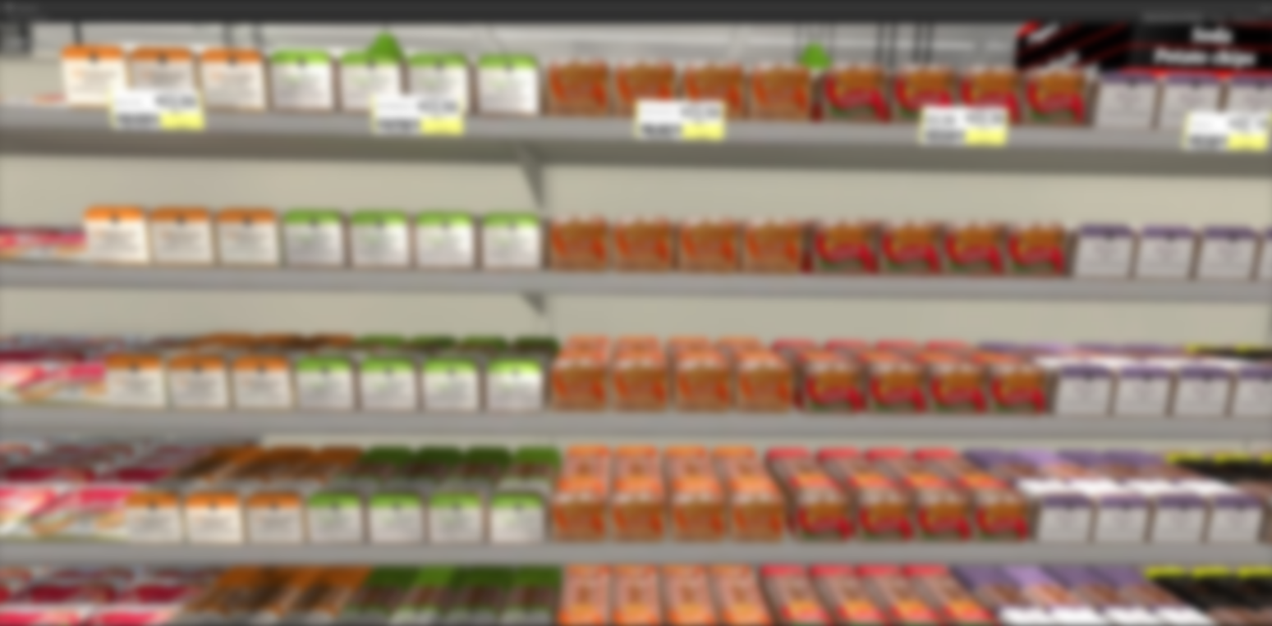
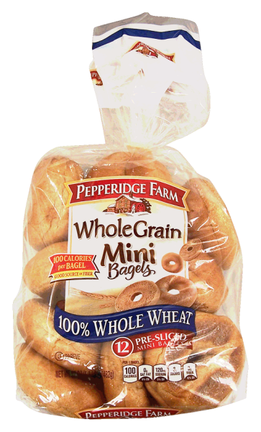
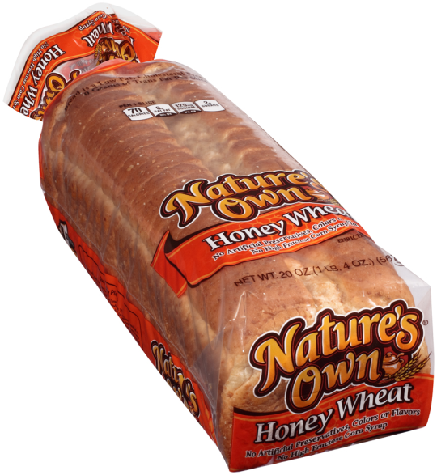
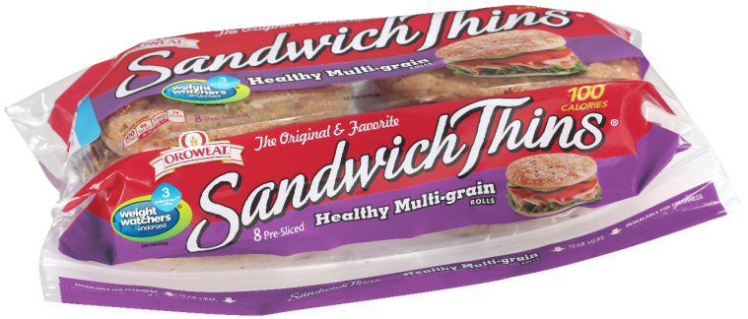
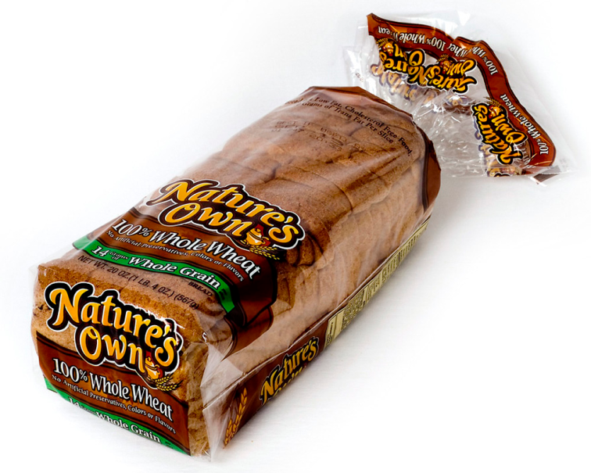
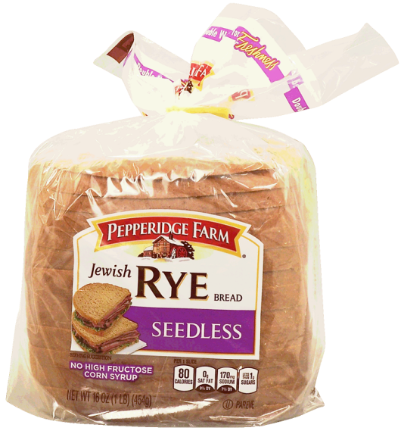
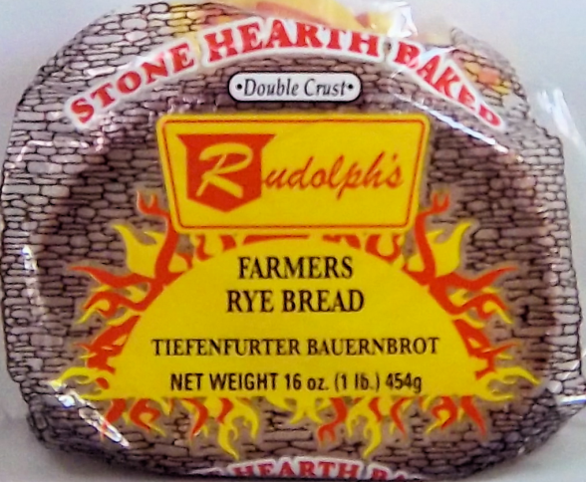
Packaged Bread
Return to map
f

Slide 9
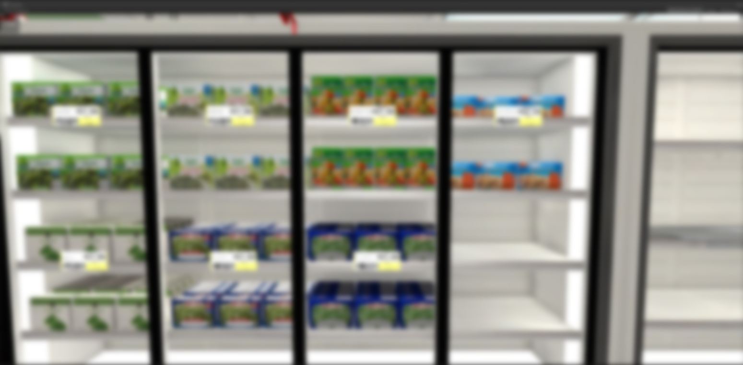
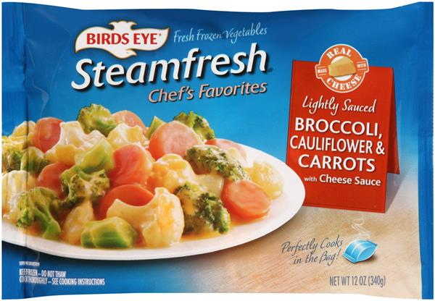
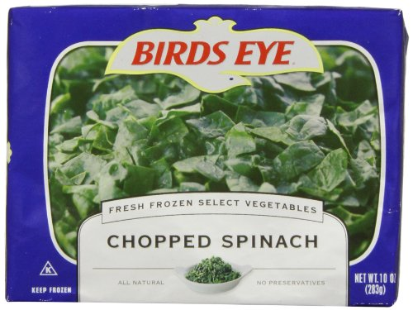
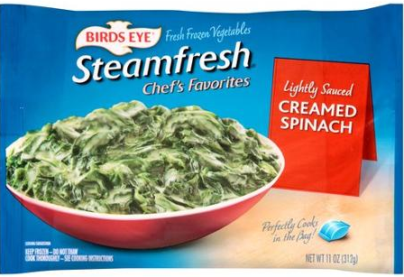
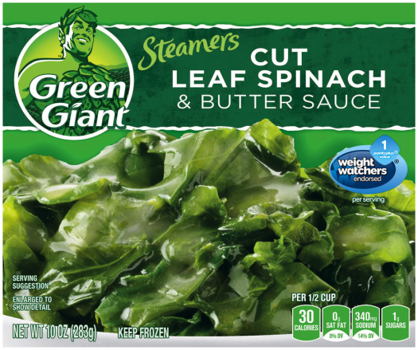
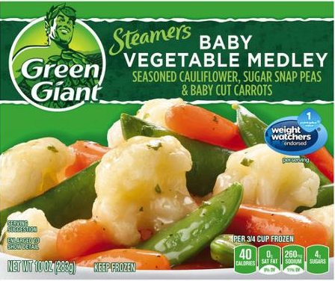
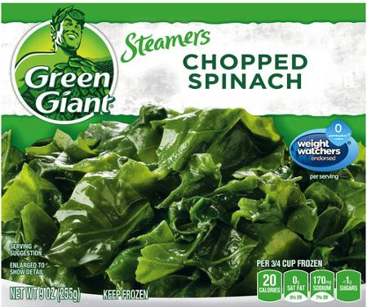
Frozen Vegetables
Return to map
g

Slide 10
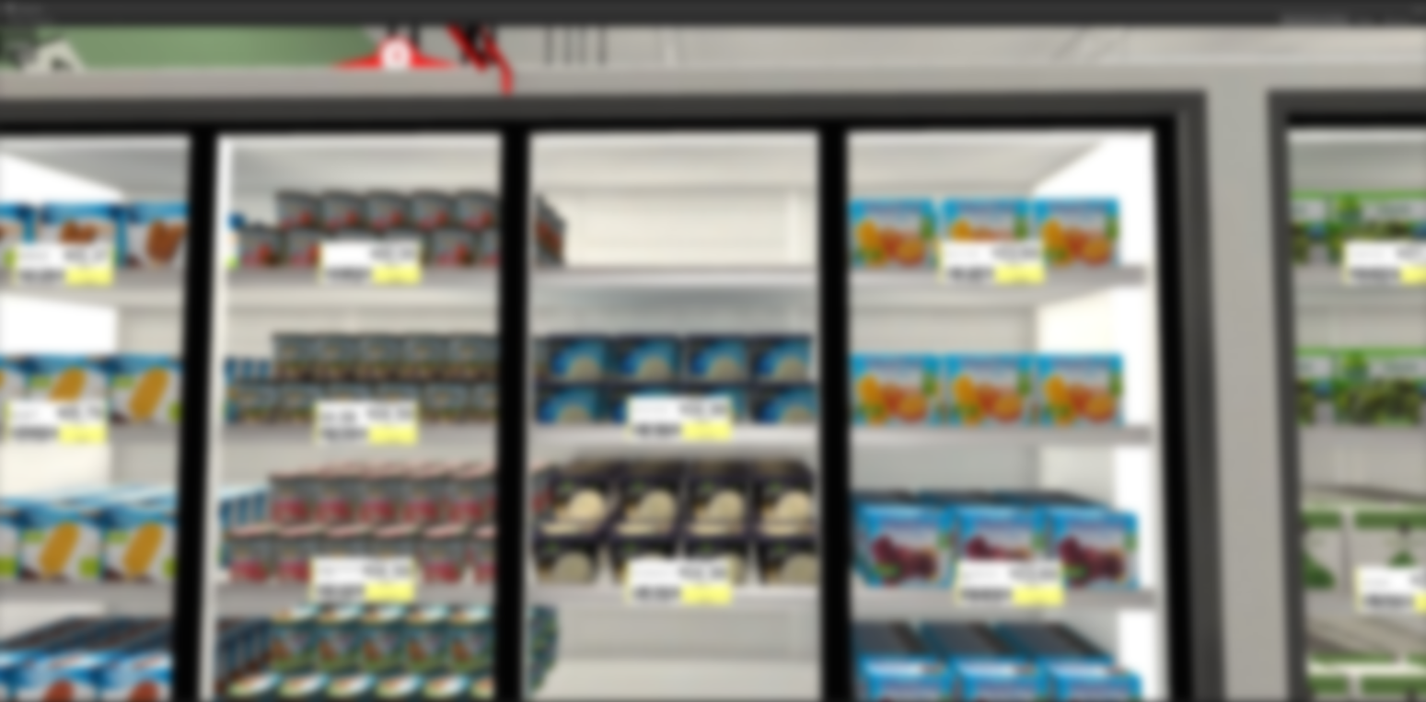
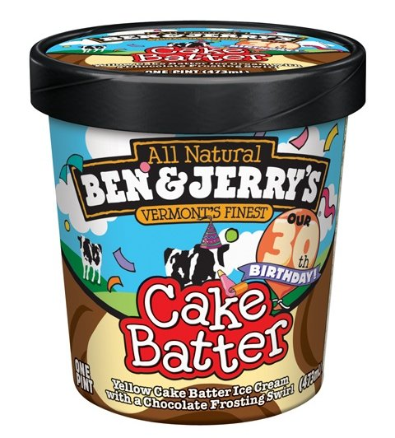
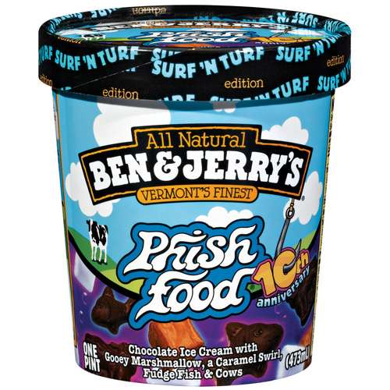
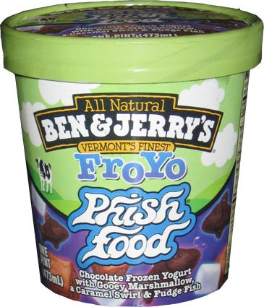
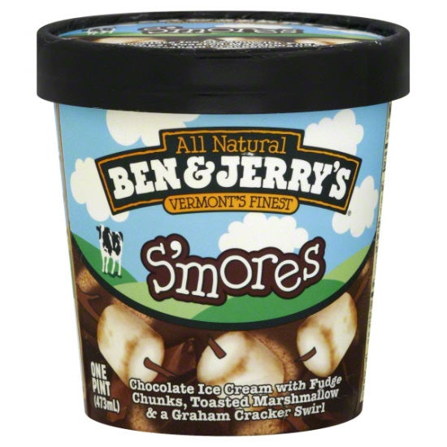
Ice Cream
Return to map
h

Slide 11
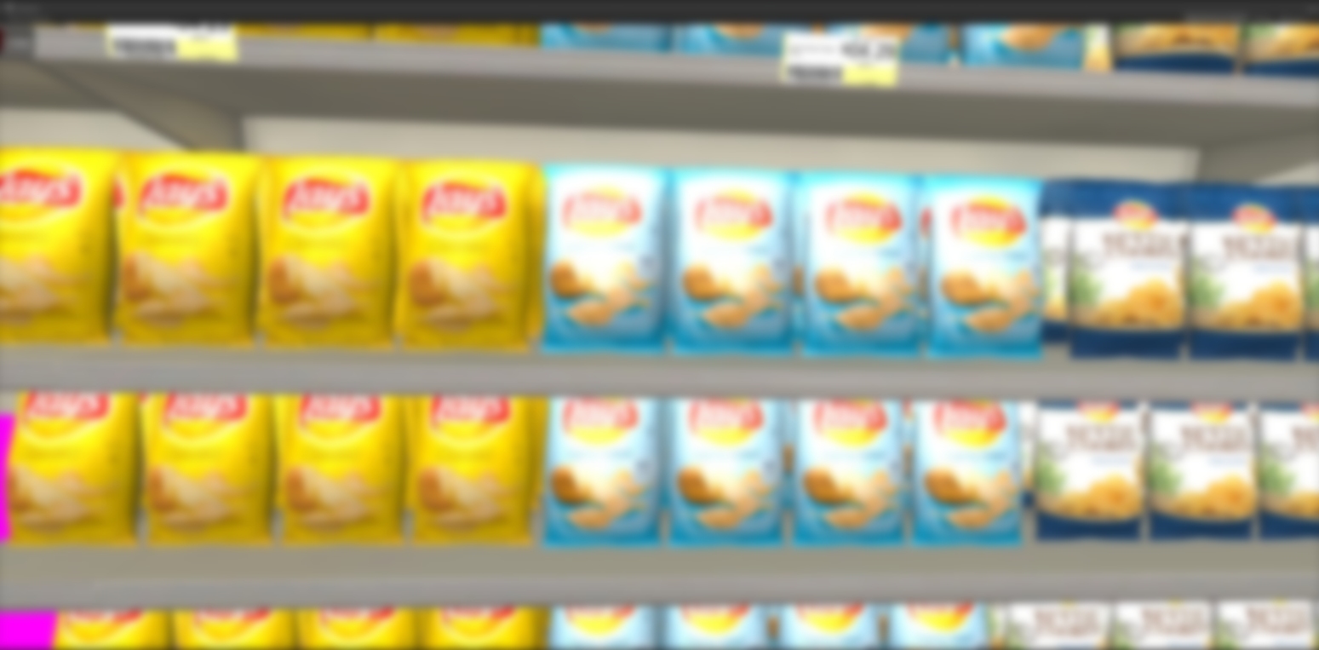
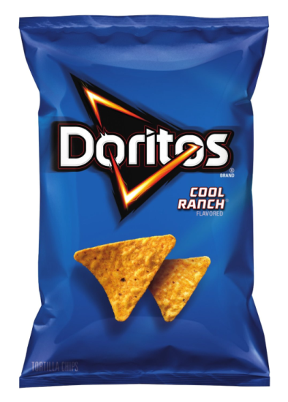
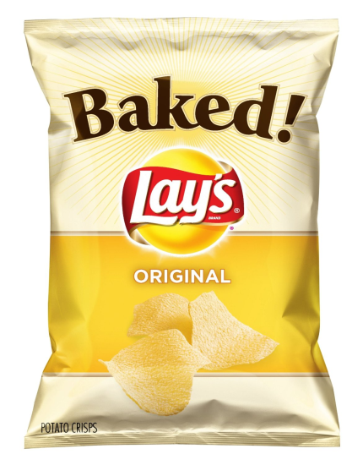
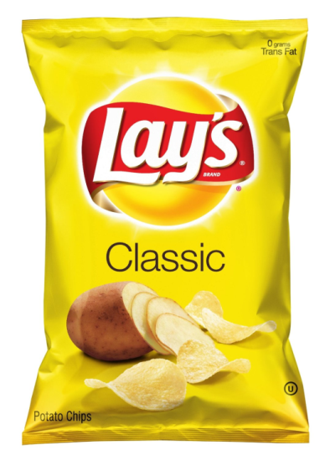
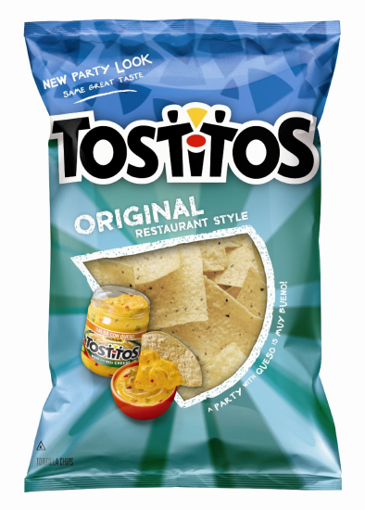
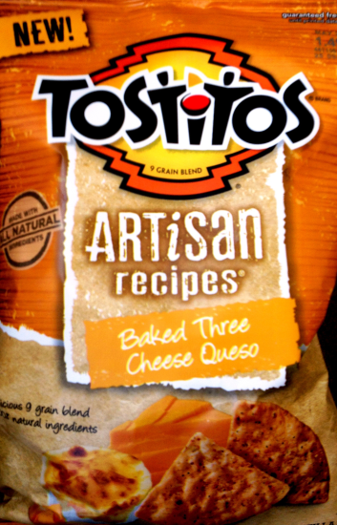
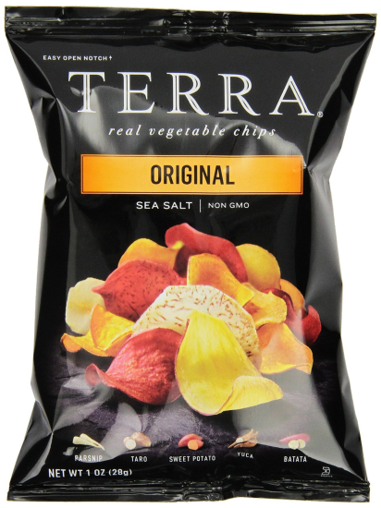
Potato Chips
Return to map
i

Slide 12
Juice / Bottled Water
Return to map
There are no list items in this section
j

Slide 13
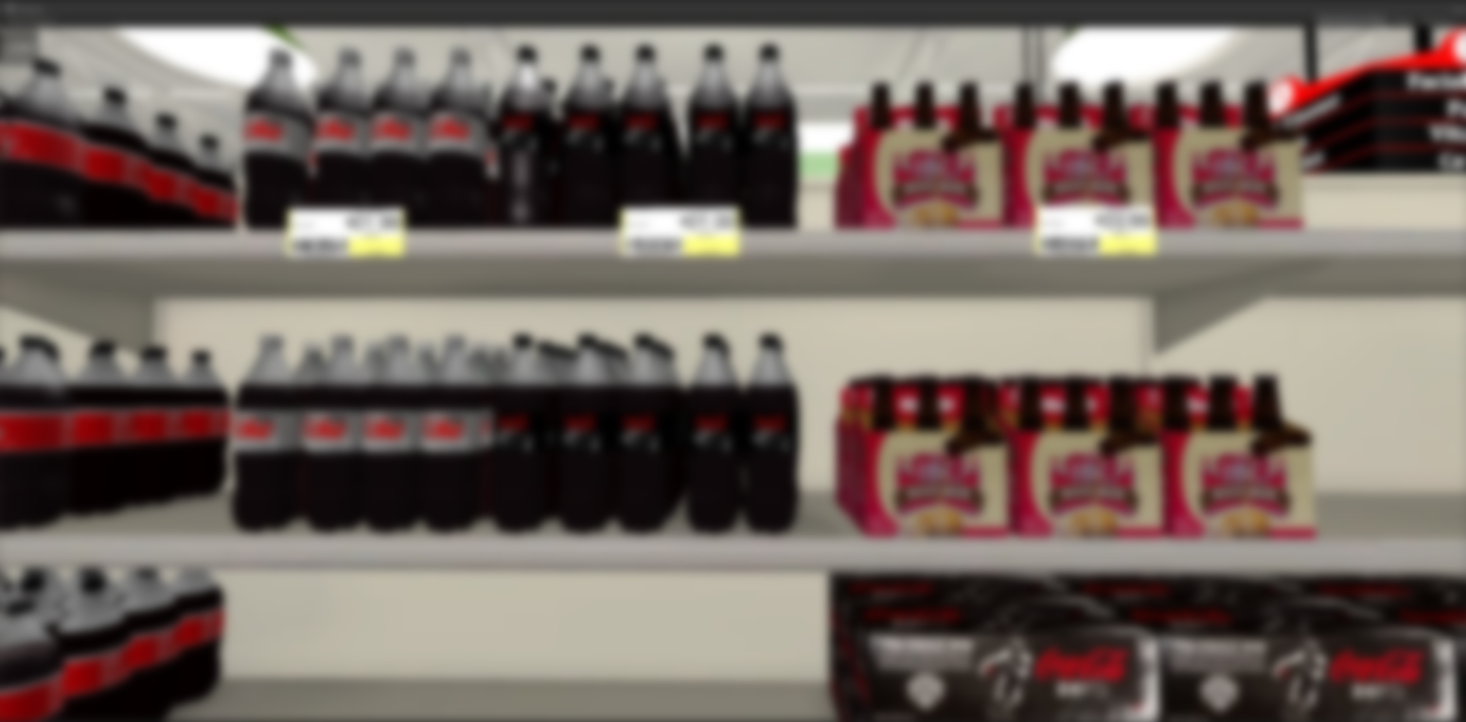
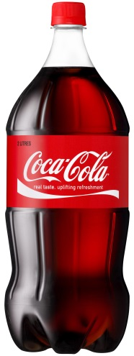
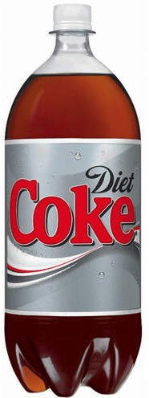
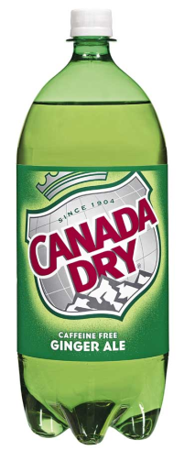
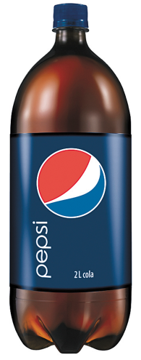
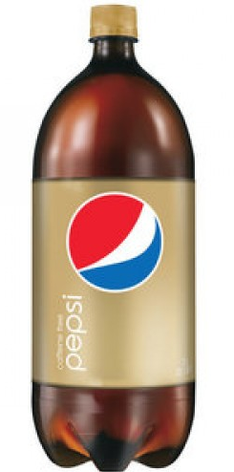
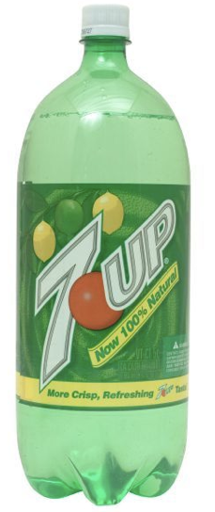
Soda
Return to map
k

Slide 14
Paper Towels / Toilet
Return to map
There are no list items in this section
l

Slide 15
Pasta
Return to map
There are no list items in this section
m

Slide 16
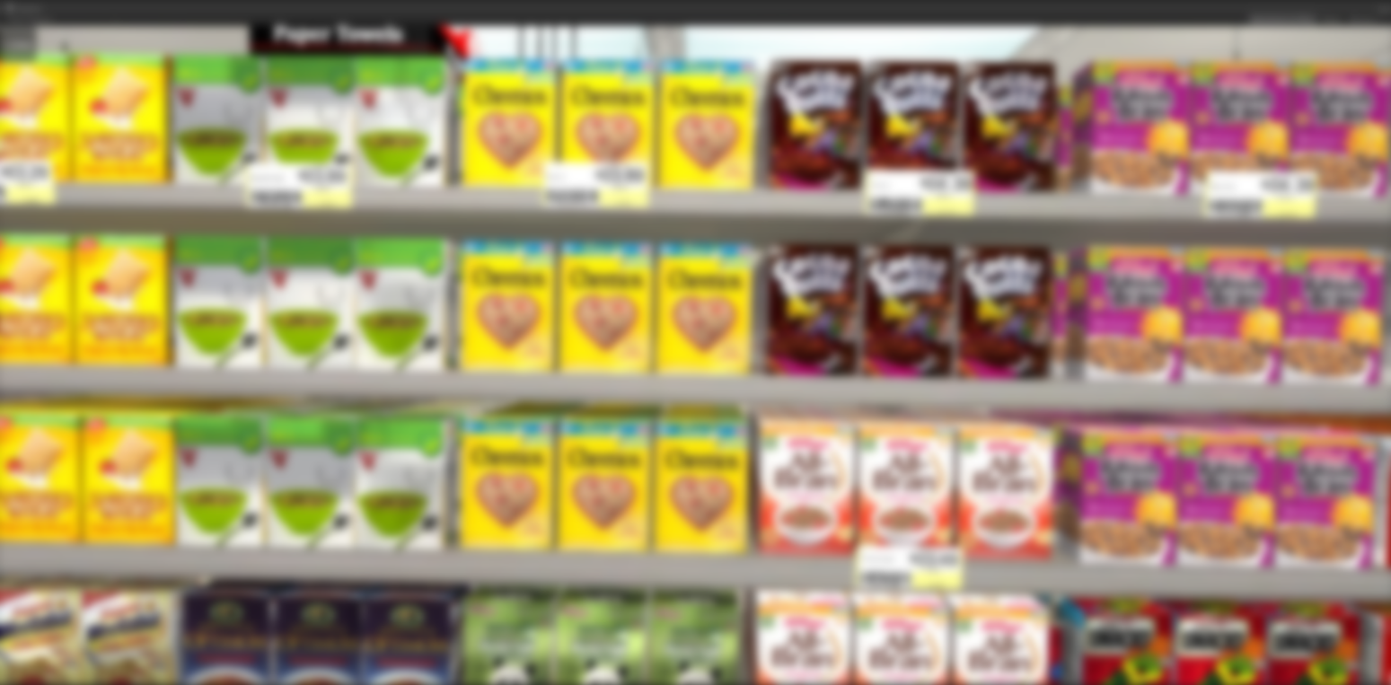
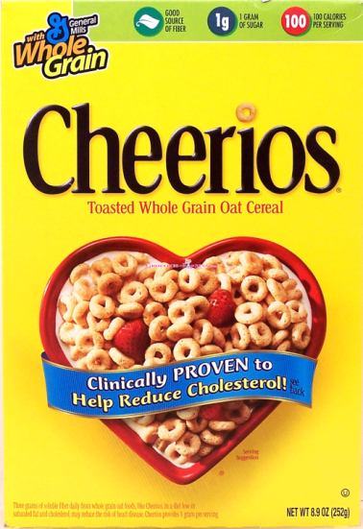
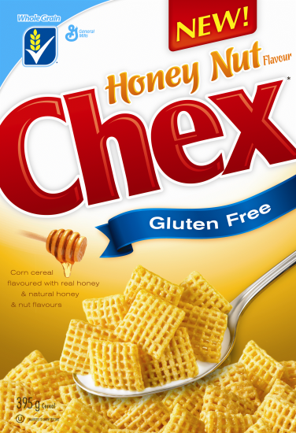
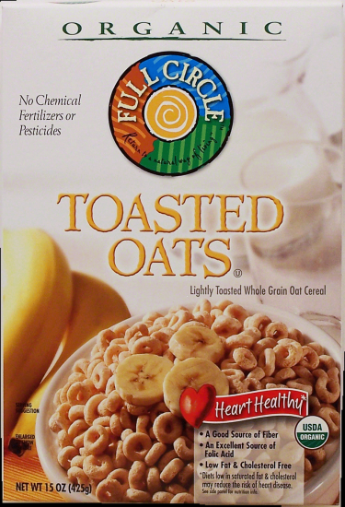
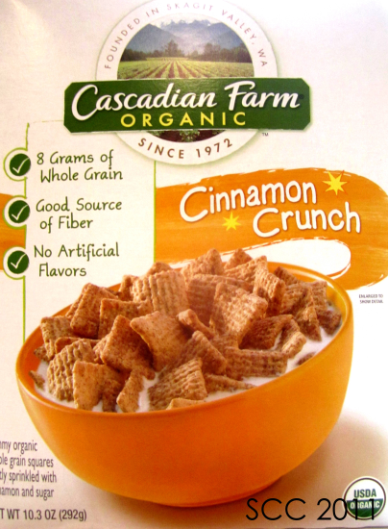
Cereal
Return to map
n

Slide 17
Mouthwash / Dental
Return to map
There are no list items in this section
o

Slide 18
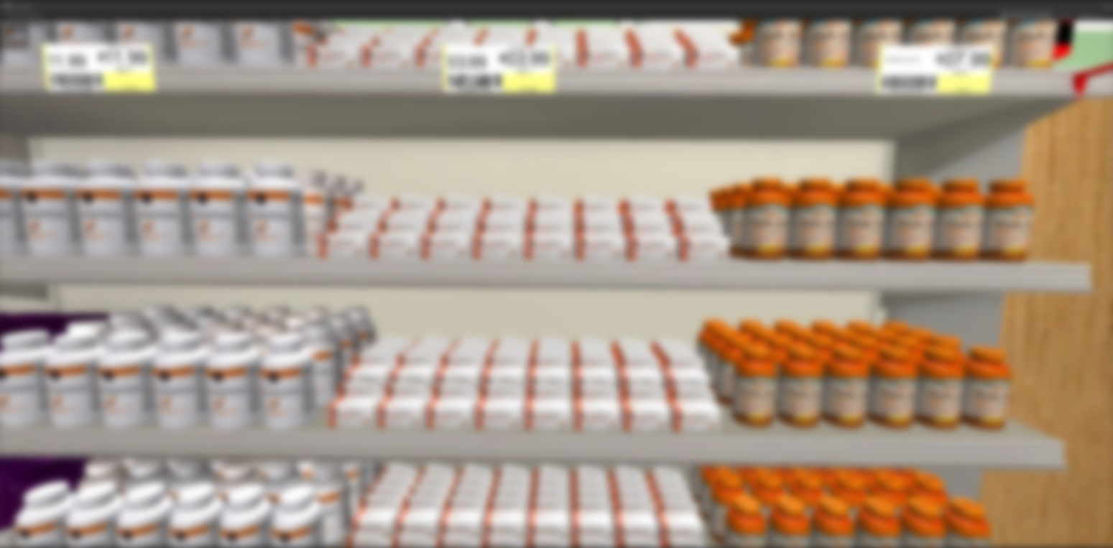
Vitamins
Return to map
p

Slide 19
Facial Tissue
Return to map
There are no list items in this section
q

Slide 20
Candy / Cookies
Return to map
There are no list items in this section
r

Slide 21
Flour / Sugar
Return to map
There are no list items in this section
s

Slide 22
Rice / Condiments
Return to map
There are no list items in this section
t

Slide 23
Laundry Detergent
Return to map
There are no list items in this section
u

Slide 24
Household
Return to map
There are no list items in this section
v

Slide 25
Coffee
Return to map
There are no list items in this section
w

Slide 26
Canned Vegetables
Return to map
x

Slide 27
Canned Meats
Return to map
There are no list items in this section
y

Slide 28
Soup
Return to map
z

Slide 29
Cheese
Return to map
aa

Slide 30
Milk
Return to map
ab

Slide 31
Sandwich Meats
Return to map
ac

Slide 32
Deli
Return to map
There are no list items in this section
ad

Slide 33
Thank you! This concludes the test.
We are now finished with this memory task for today.

