Slide 1
In a moment, I will read you the same list of words one last time
Your job is to try to remember the words, and then,
using the map of the grocery store that follows, find each item.
When you have found the item, click it.
If there are other items in the same section you want to select, go ahead and do so
When you are done with a particular area, click “return to map” to select another area
Return to map

Slide 2
Study the map.
Then click here
to advance
Fresh Bakery
Magazines
START HERE
Fresh Fruit
Beer/Wine
Fresh Vegetables
Packaged Bread
Frozen Vegetables / Ice Cream
Potato Chips
Paper Towels / Toilet
Soda
Juice / Bottled Water
Pasta
Cereal
Facial Tissue
Vitamins
Mouthwash/ Dental
Candy / Cookies
Flour / Sugar
Rice / Condiments
Coffee
Household
Laundry Detergent
Canned Vegetables / Meats
Soups
Cheese / Milk / Sandwich Meats
TO THE CASHIER
Deli

Slide 3
Now, I will read you the same list of grocery items one last time
Listen carefully, as when I am done, you will be asked to remember, and find, each object in the grocery store, including the ones you remembered the first two times.

Slide 4
Ready?
Click here to begin

Slide 5
Caffeine Free Pepsi

Slide 6
Tostitos Artisan Baked Three Cheese Chips

Slide 7
Nature's Own Honey Wheat Bread

Slide 8
Terra Original Vegetable Chips

Slide 9
7-Up

Slide 10
Rudolph's Farmer's Rye Bread

Slide 11
Baked Lay's Potato Chips

Slide 12
Canada Dry

Slide 13
Pepperidge Farm Whole Grain Mini Bagels

Slide 14
Doritos Cool Ranch Chips

Slide 15
Coca Cola

Slide 16
Arnold's Sandwich Thins

Slide 17
Tester: Plug your headphones in before the slide advances If you are ready to begin finding, click here

Slide 18
Fresh Bakery
Magazines
Fresh Fruit
Beer/Wine
Fresh Vegetables
Packaged Bread
Frozen Vegetables Ice Cream
Potato Chips
Paper Towels / Toilet
Soda
Juice / Bottled Water
Pasta
Cereal
Facial Tissue
Vitamins
Mouthwash/ Dental
Candy / Cookies
Flour / Sugar
Rice / Condiments
Coffee
Household
Laundry Detergent
Canned Vegetables Canned Meats
Soups
Cheese Milk Sandwich Meats
Deli
If you are finished, click here

Slide 19
Magazines
Return to map
There are no list items in this section
a

Slide 20
Bakery
Return to map
There are no list items in this section
b

Slide 21
Fresh Fruit
Return to map
There are no list items in this section
c

Slide 22
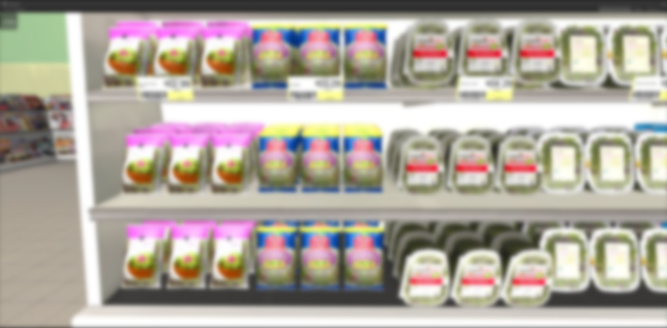
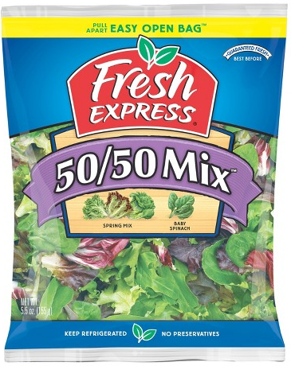
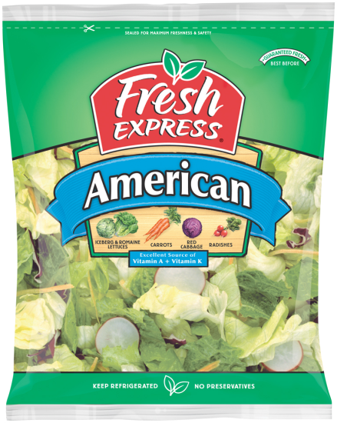
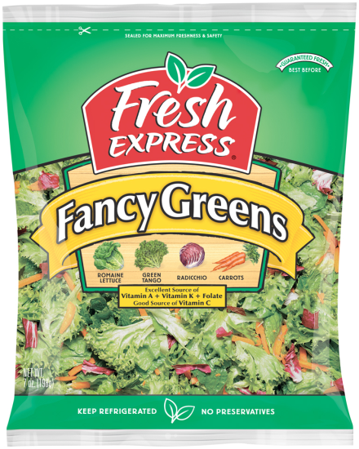
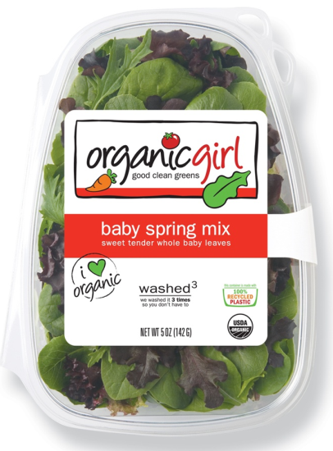
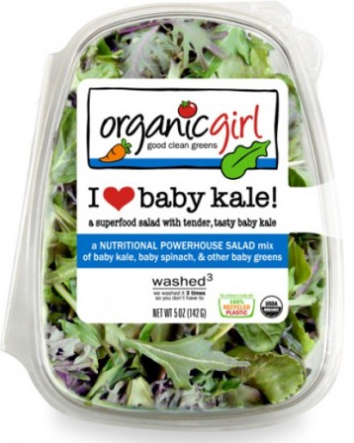
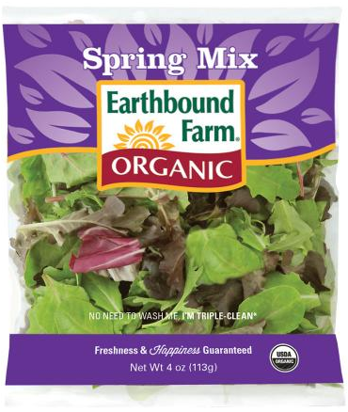
Fresh Vegetables
Return to map
d

Slide 23
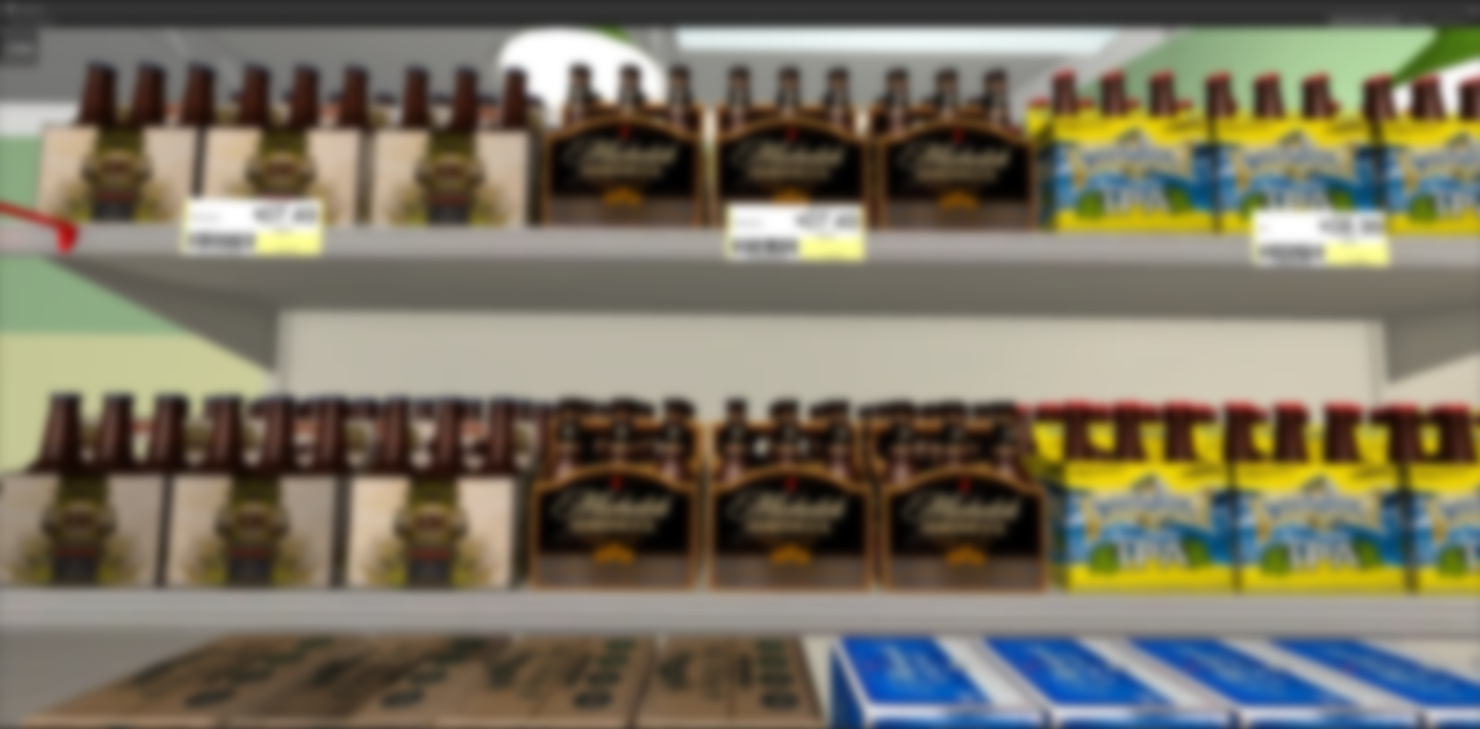
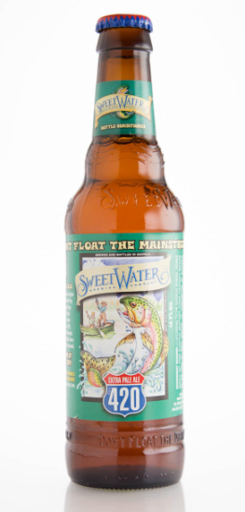
Beer/Wine
Return to map
e

Slide 24
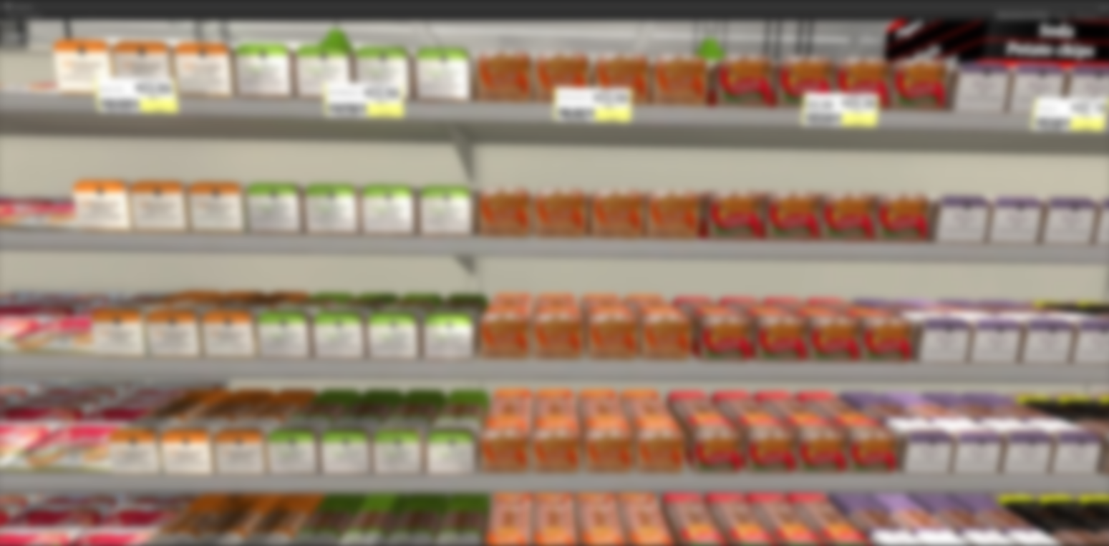
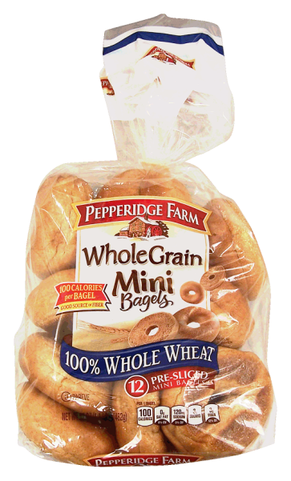
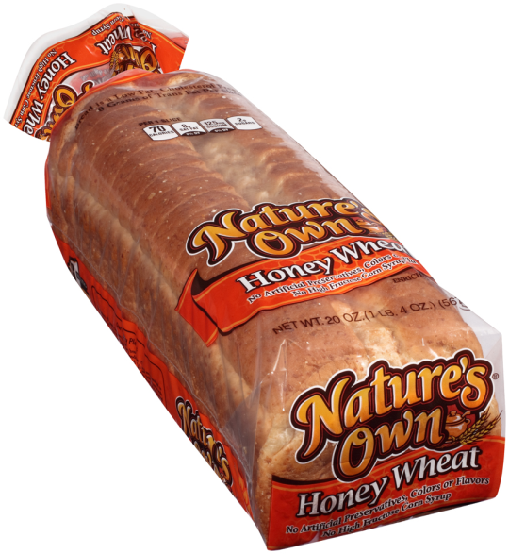
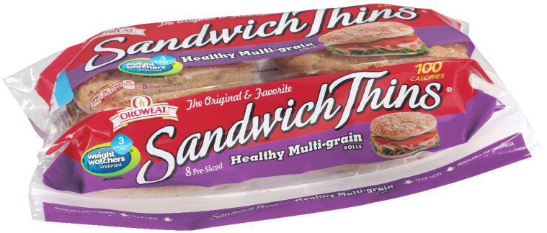
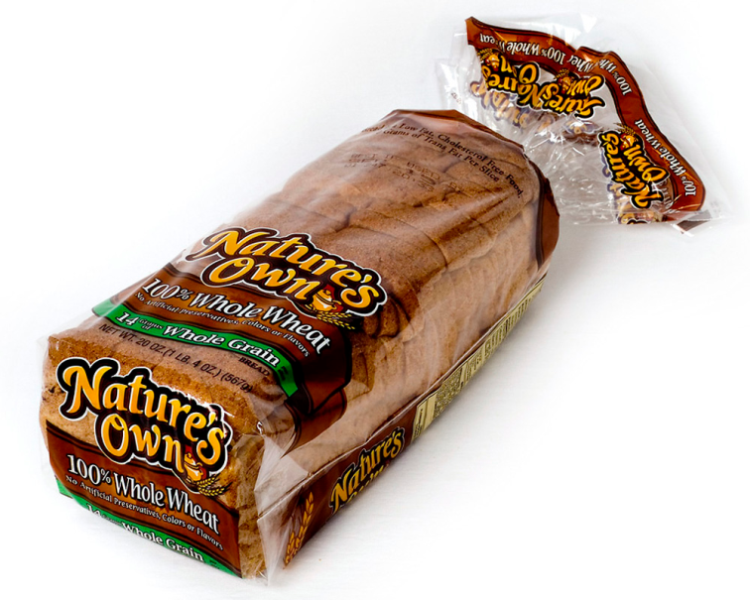
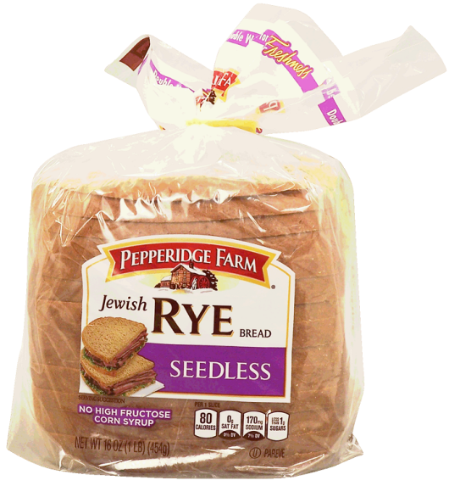
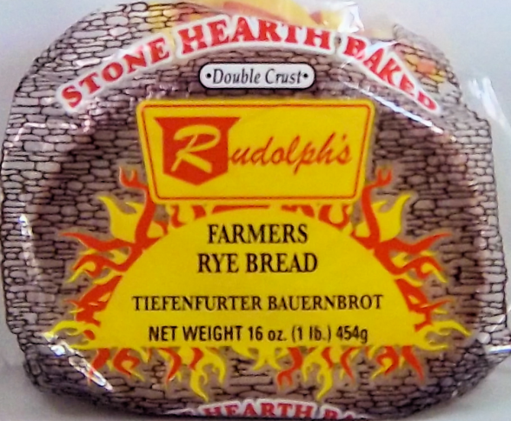
Packaged Bread
Return to map
f

Slide 25
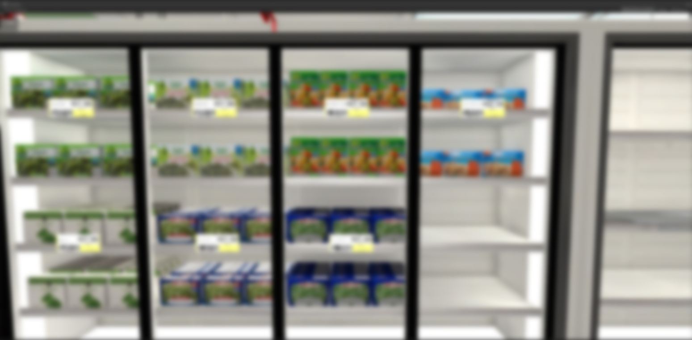
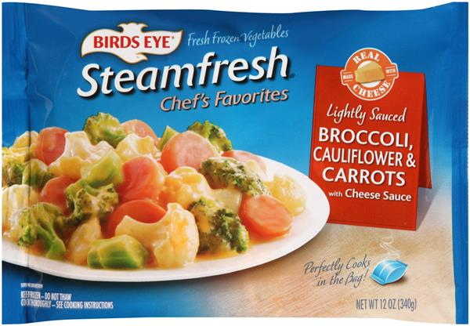
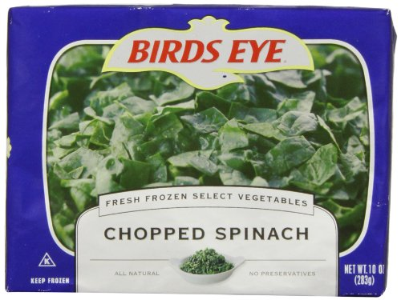
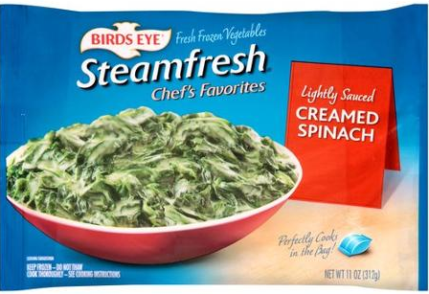
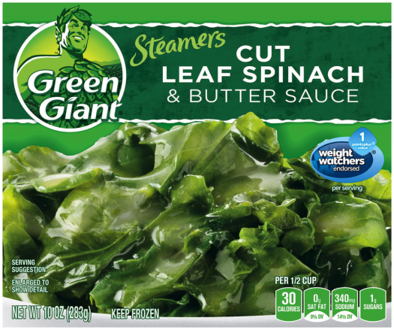
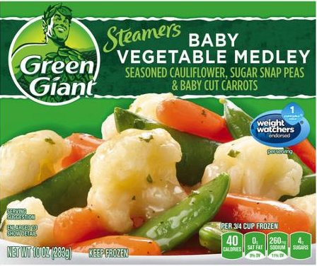
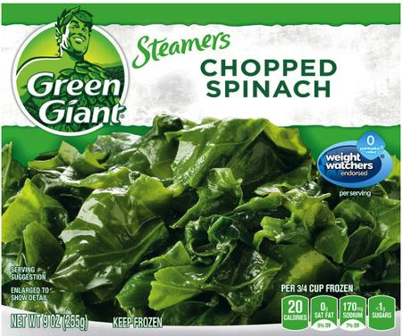
Frozen Vegetables
Return to map
g

Slide 26
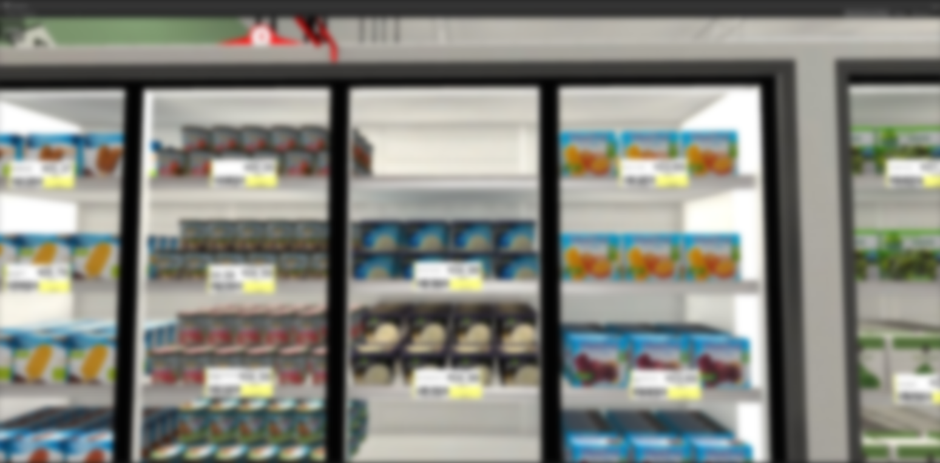
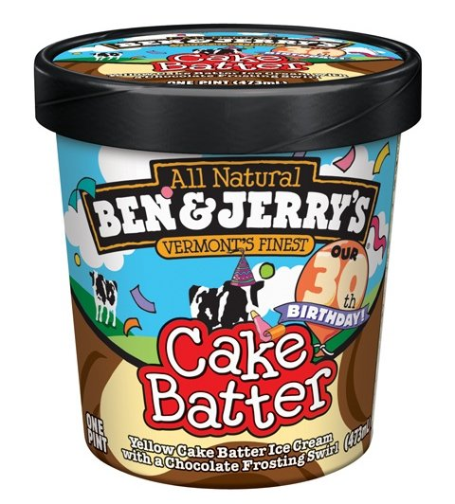
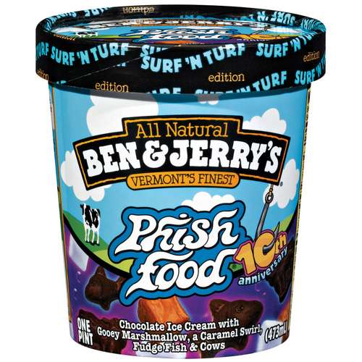
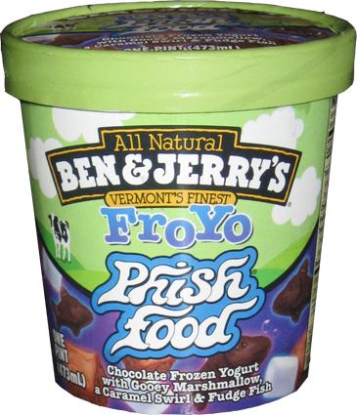
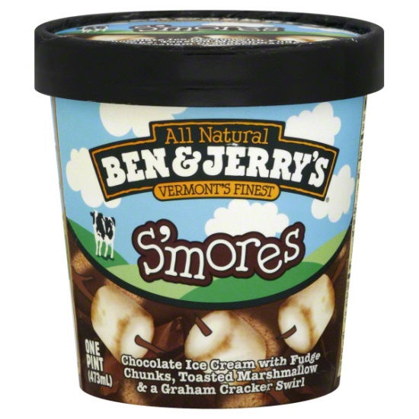
Ice Cream
Return to map
h

Slide 27
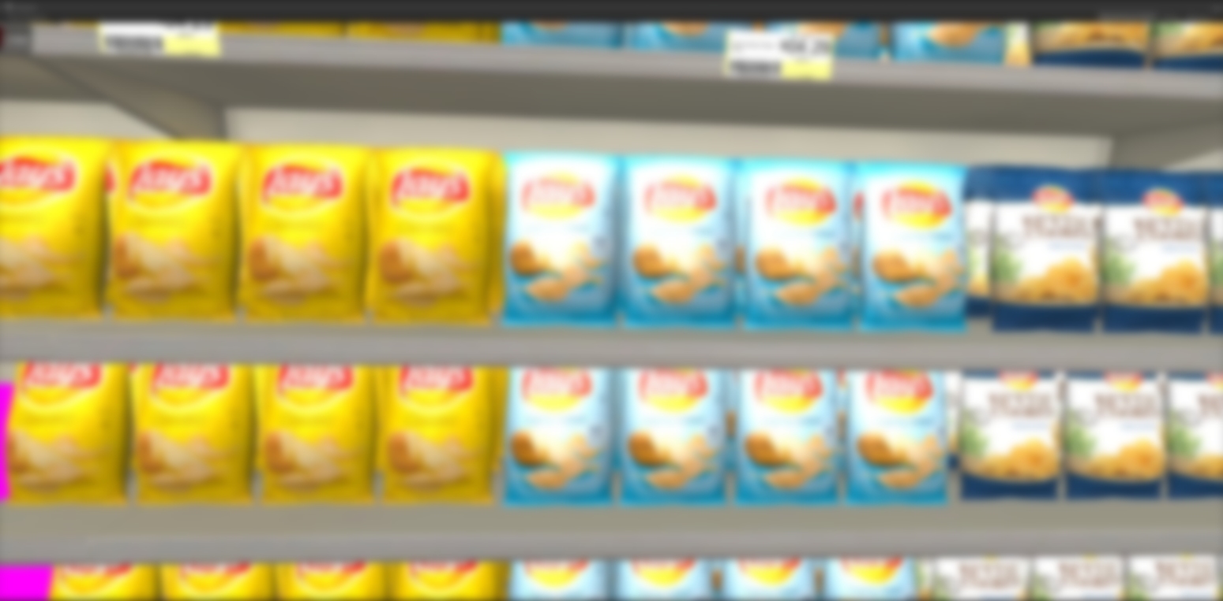
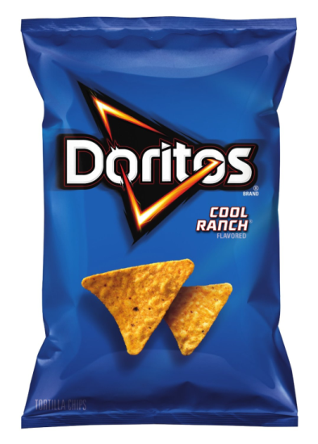
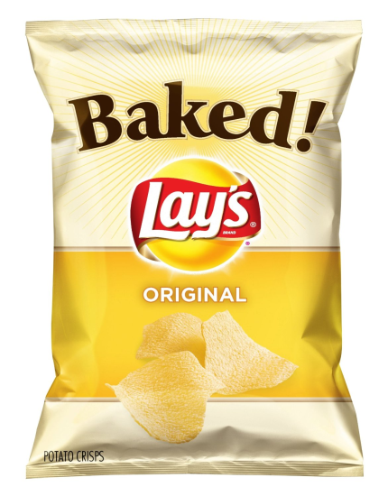
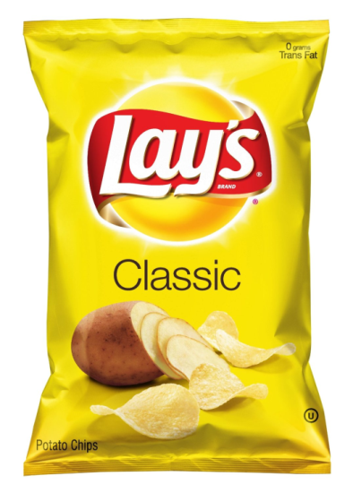
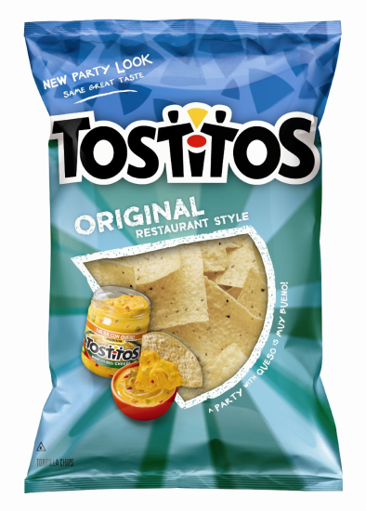
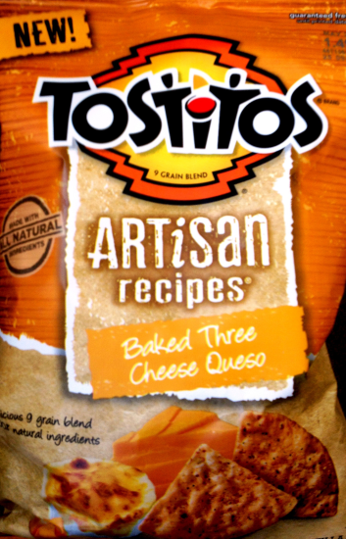
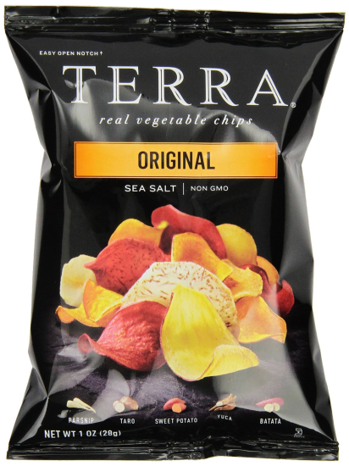
Potato Chips
Return to map
i

Slide 28
Juice / Bottled Water
Return to map
There are no list items in this section
j

Slide 29
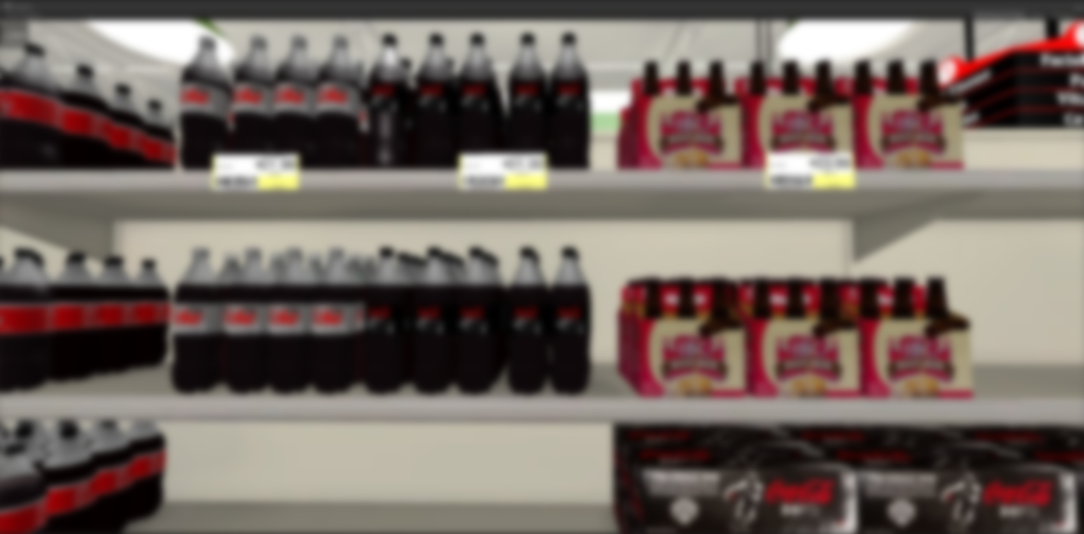
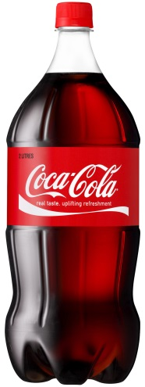
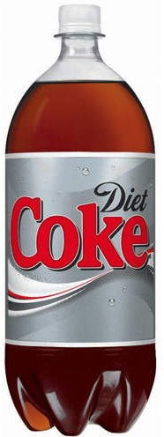
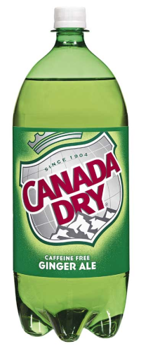
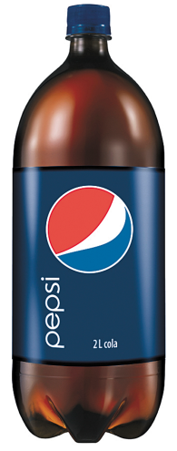
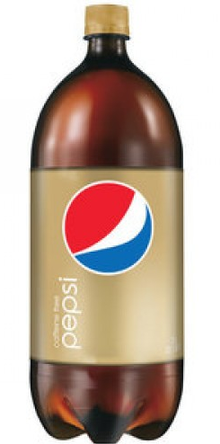
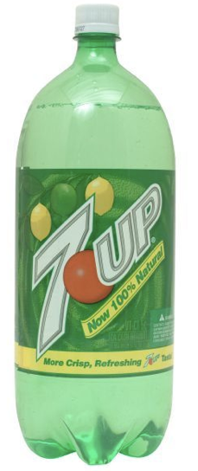
Soda
Return to map
k

Slide 30
Paper Towels / Toilet
Return to map
There are no list items in this section
l

Slide 31
Pasta
Return to map
There are no list items in this section
m

Slide 32
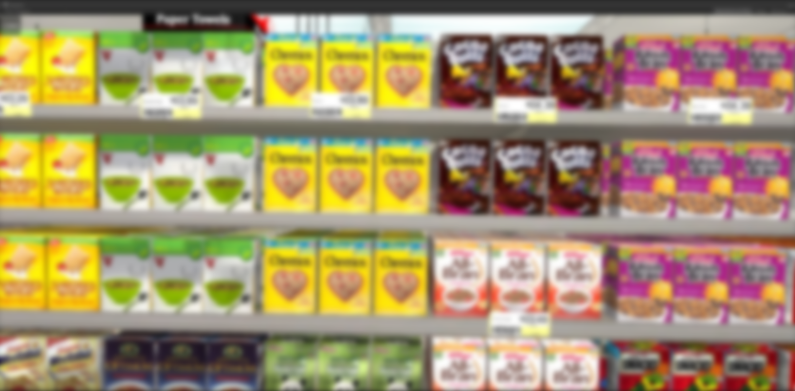
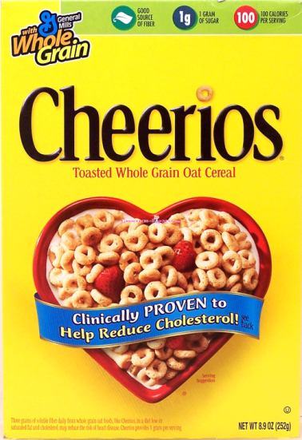
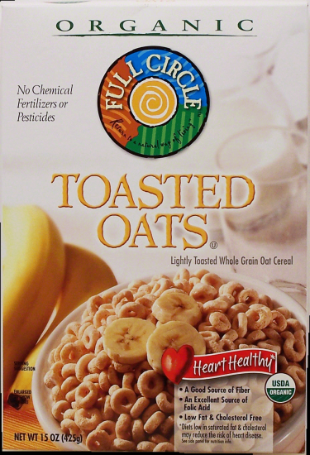
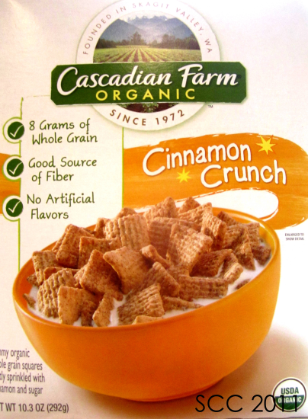
Cereal
Return to map
n

Slide 33
Mouthwash / Dental
Return to map
There are no list items in this section
o

Slide 34
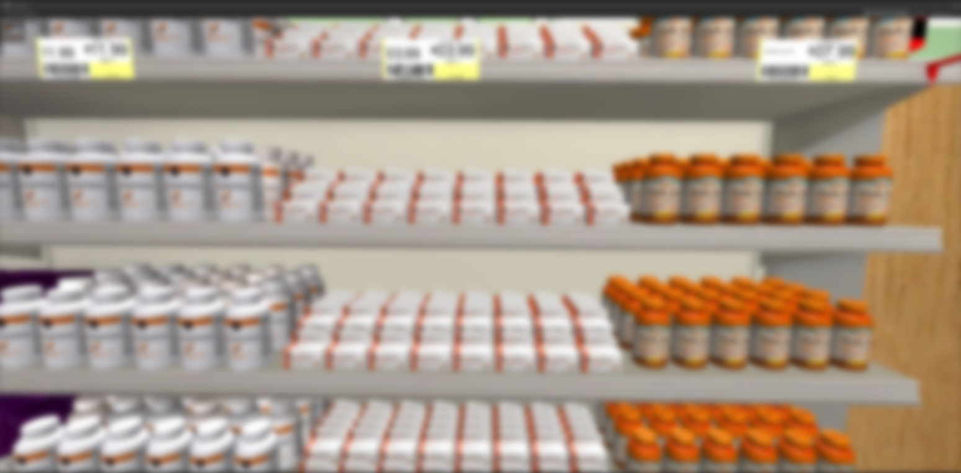
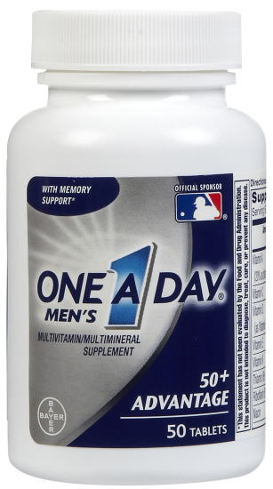
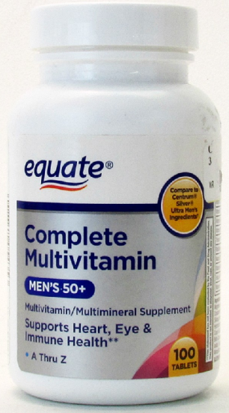
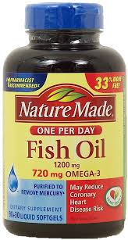
Vitamins
Return to map
p

Slide 35
Facial Tissue
Return to map
There are no list items in this section
q

Slide 36
Candy / Cookies
Return to map
There are no list items in this section
r

Slide 37
Flour / Sugar
Return to map
There are no list items in this section
s

Slide 38
Rice / Condiments
Return to map
There are no list items in this section
t

Slide 39
Laundry Detergent
Return to map
There are no list items in this section
u

Slide 40
Household
Return to map
There are no list items in this section
v

Slide 41
Coffee
Return to map
There are no list items in this section
w

Slide 42
Canned Vegetables
Return to map
x

Slide 43
Canned Meats
Return to map
There are no list items in this section
y

Slide 44
Soup
Return to map
z

Slide 45
Cheese
Return to map
aa

Slide 46
Milk
Return to map
ab

Slide 47
Sandwich Meats
Return to map
ac

Slide 48
Deli
Return to map
There are no list items in this section
ad

Slide 49
Thank you! This concludes the test for now.
Remember this list of grocery items, because we’re going to ask you about them again later.

