Slide 1
This is a test of your ability to identify and compare prices
On the screens that follow, you will see common grocery items
For each screen, you will be asked a question about the prices of the item or items
Click the correct answer at the bottom of the screen
Try to respond as quickly and accurately as you can

Slide 2
Tester: Plug your headphones in before the slide advances If you are ready to begin finding and comparing prices, click here

Slide 3
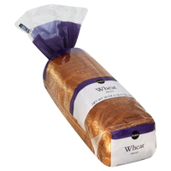
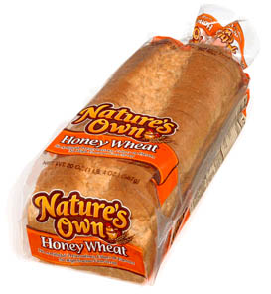
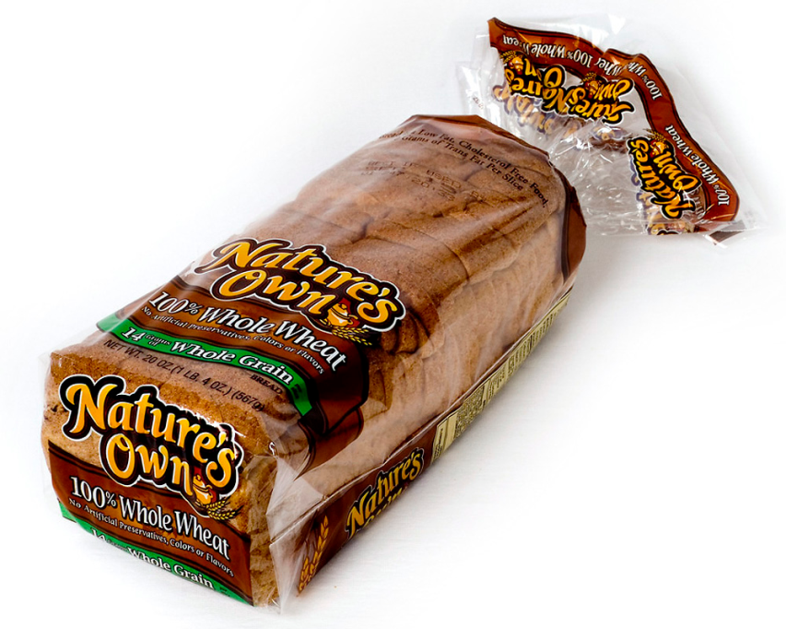
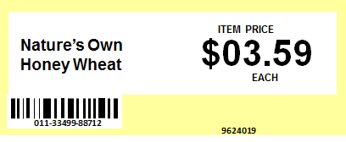
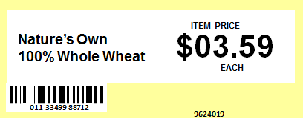
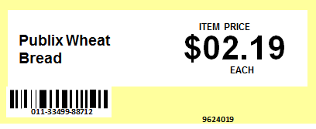
What is the price of Nature’s Own Honey Wheat?
a. $02.19
b. $03.19
c. $03.59

Slide 4
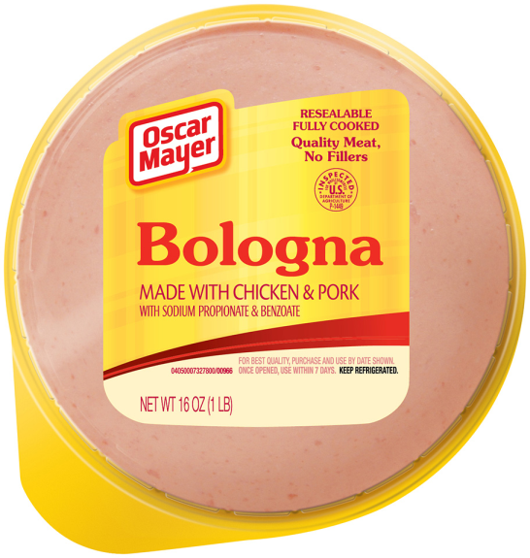
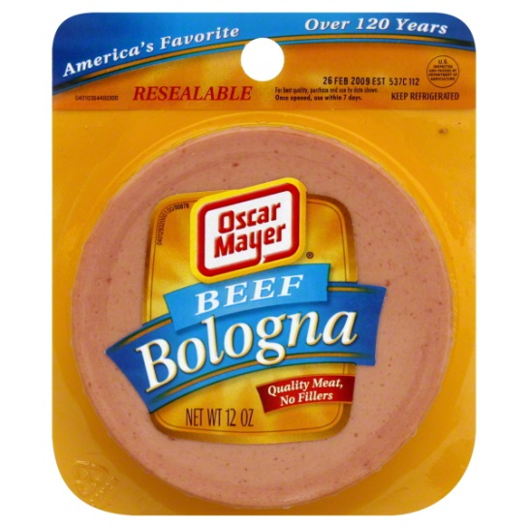
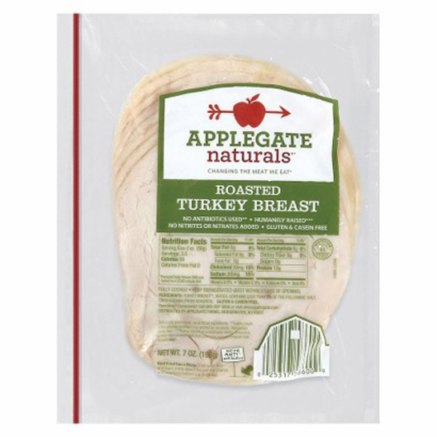
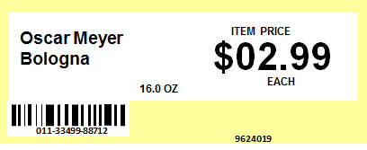
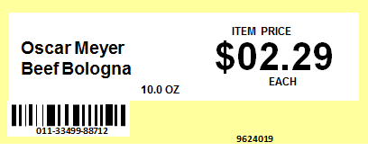
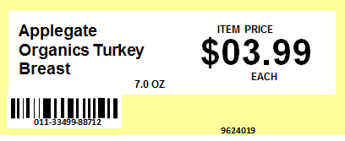
What is the price of Oscar Mayer Beef Bologna Sliced?
a. $02.29
b. $02.99
c. $03.99

Slide 5
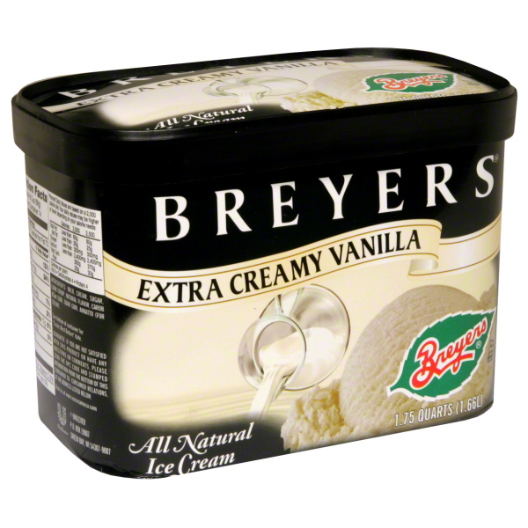
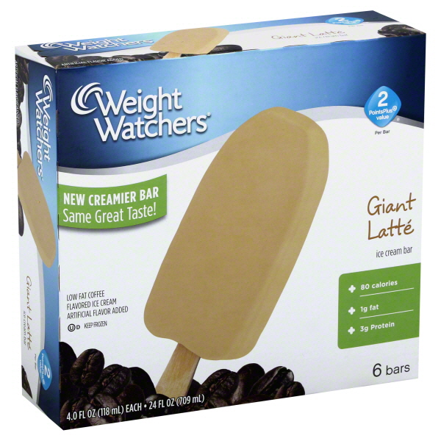
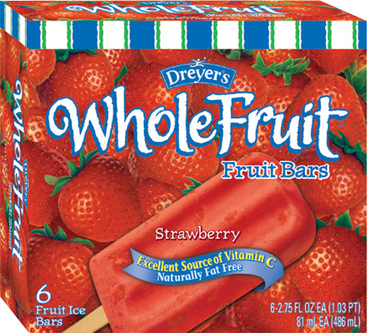
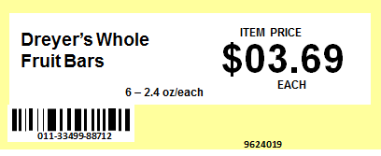
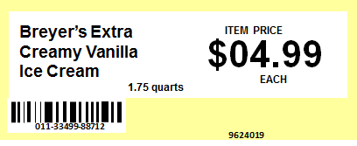
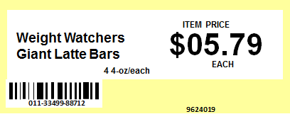
What is the price of Weight Watchers Giant Latte Ice Cream Bars?
a. $03.69
b. $04.99
c. $05.79

Slide 6
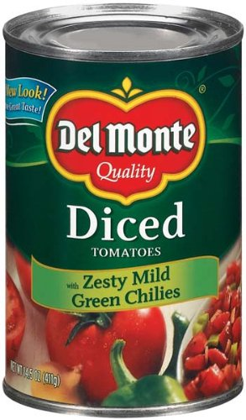
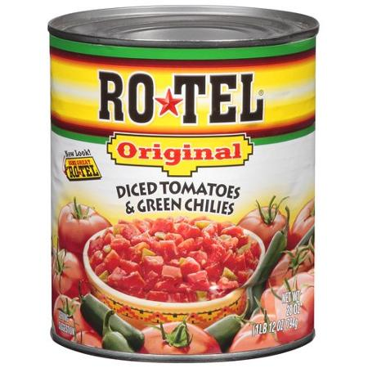
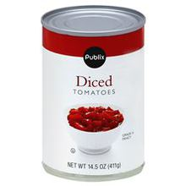
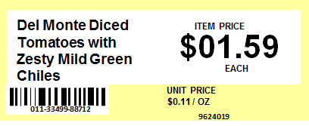
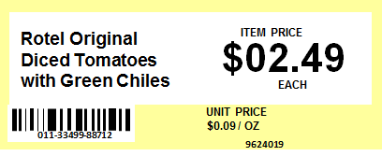
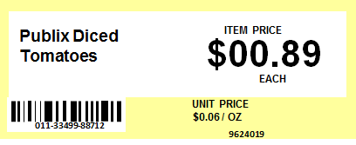
What is the unit price of Rotel Original Diced Tomatoes with Green Chiles?
a. $00.06/oz
b. $00.09/oz
c. $00.11/oz

Slide 7
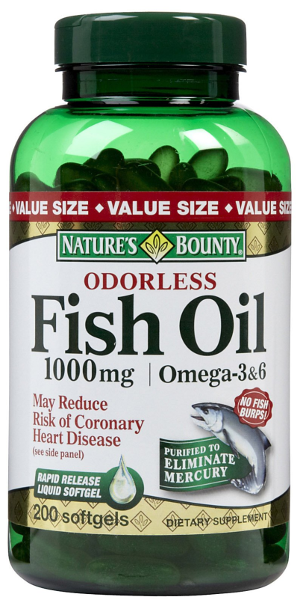
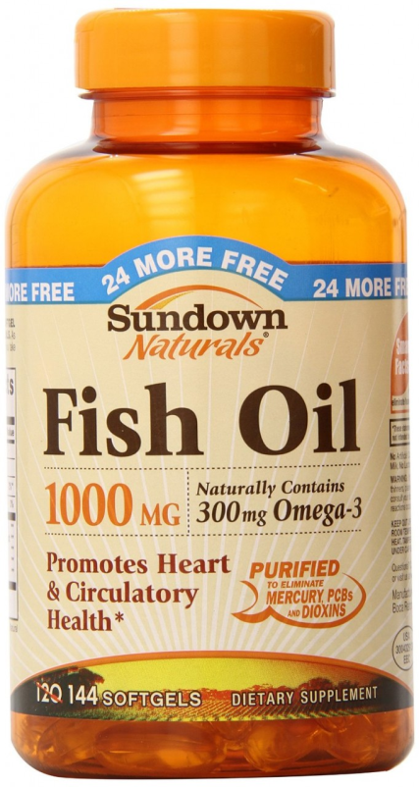
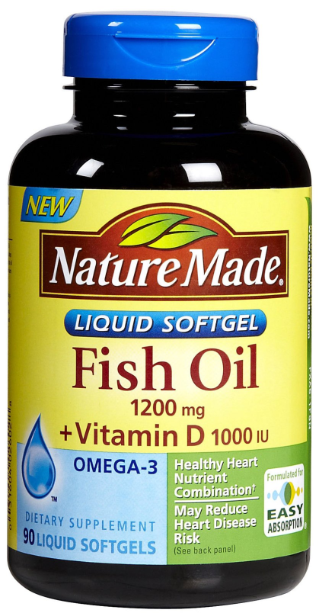
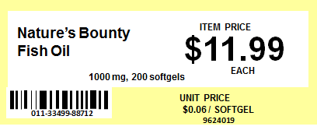
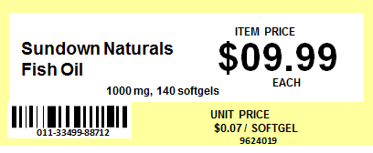
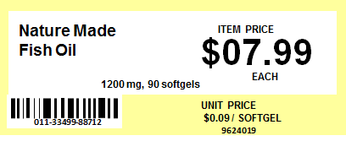
What is the unit price of Sundown Naturals 1000 mg fish oil?
a. $00.06/softgel
b. $00.07/softgel
c. $00.09/softgel

Slide 8
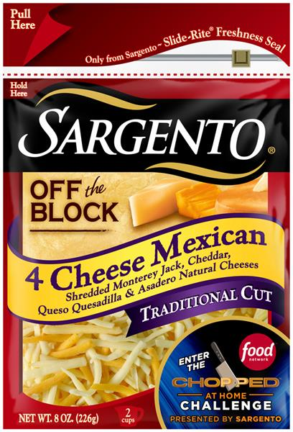
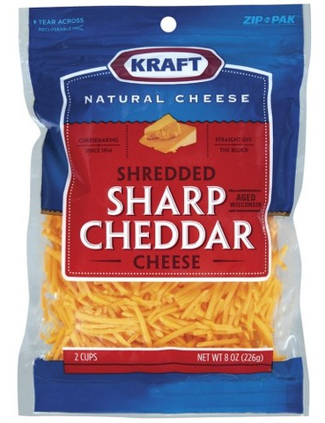
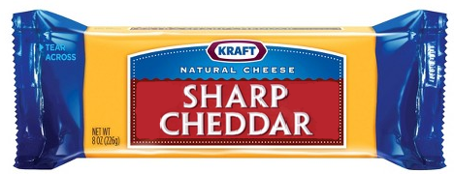
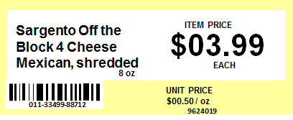
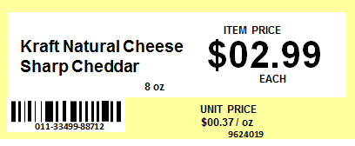
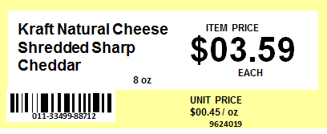
What is the unit price of Kraft Shredded Sharp Cheddar Cheese?
a. $00.37 / oz
b. $00.45 / oz
c. $00.50 / oz

Slide 9
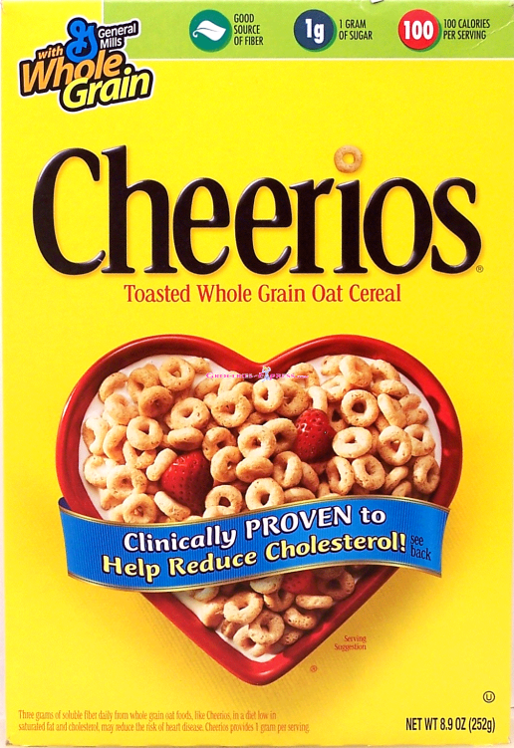
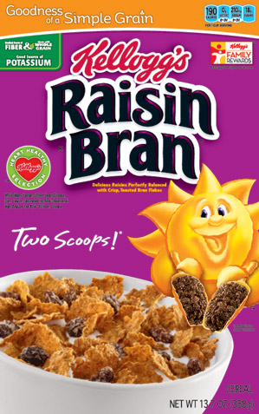
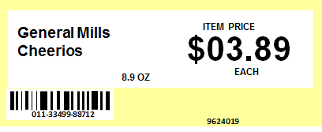
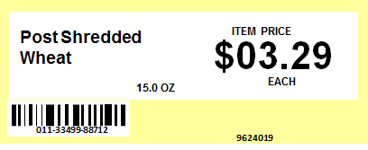
What is the unit price of Kellogg’s Raisin Bran?
a. $00.19/oz
b. $00.22/oz
c. $00.44/oz

Slide 10
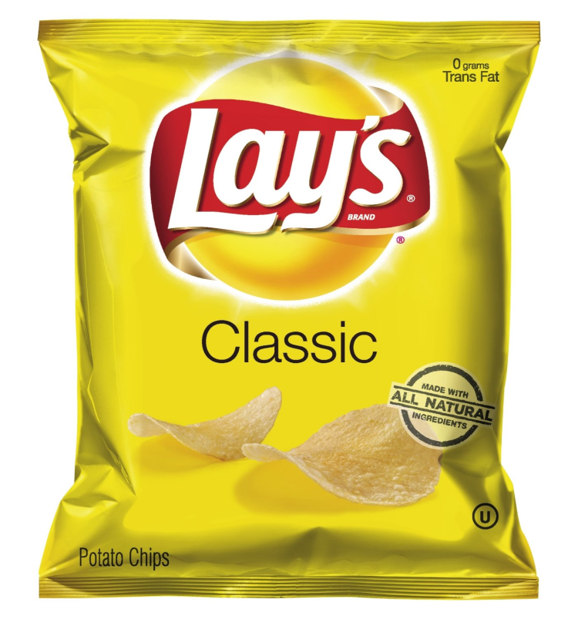
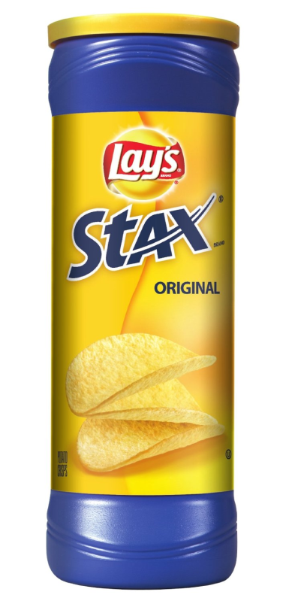
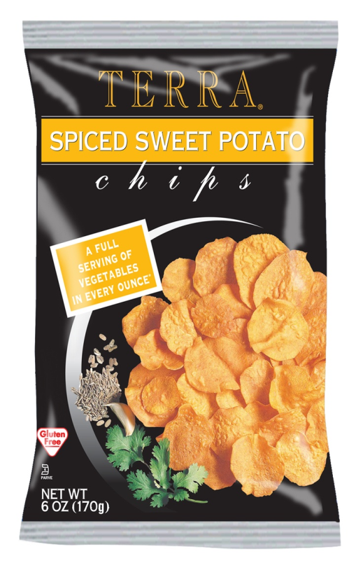
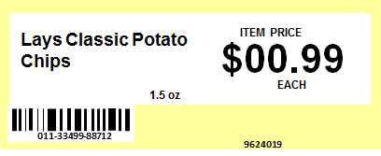
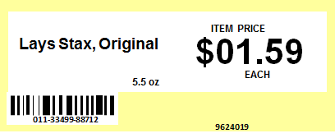
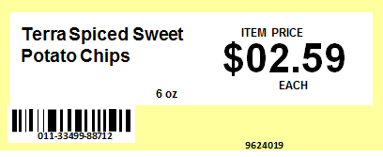
What is the unit price of Lays Classic Potato Chips?
5-1/2 oz
1.5 oz
a. $00.29 / oz
b. $00.43 / oz
c. $00.66 / oz

Slide 11
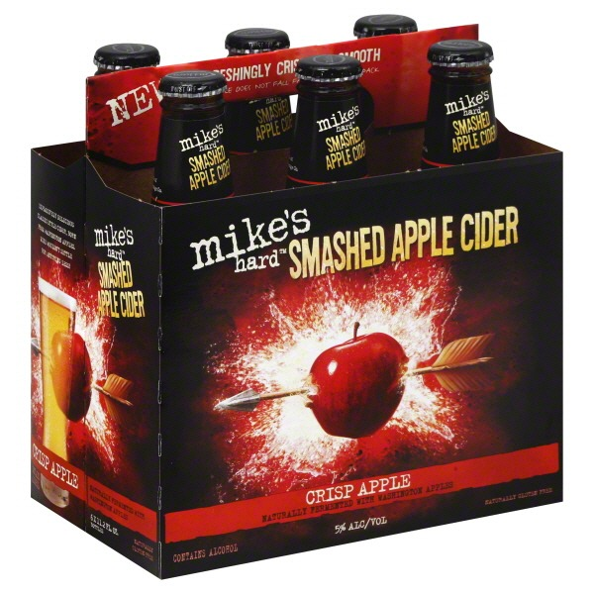
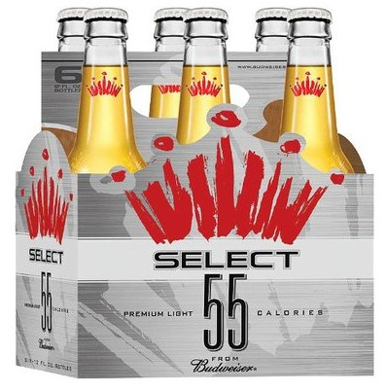
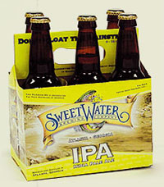
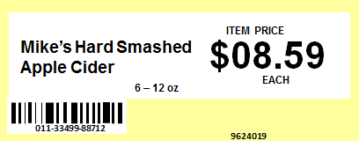
What is the unit price of Budweiser Select 55 Beer
a. $00.09 / oz
b. $00.12 / oz
c. $00.13 / oz

Slide 12
Which of these two products is least expensive in total price?
a. Michelob Amber Bock
b. Michelob Ultra

Slide 13
Which of these two products is most expensive in total price?
a. Earthbound Farm Organic
b. Organic Girl Spring Mix

Slide 14
Which of these two products is least expensive in total price?
a. Publix Reduced Calorie Bread
b. Nature’s Own Honey Wheat

Slide 15
Which of these two products is most expensive in unit price?
a. Campbell’s Chicken Noodle
b. Campbell’s Harvest Tomato

Slide 16
Which of these two products is least expensive in unit price?
a. Doritos Cool Ranch Chips
b. Lay’s Classic Potato Chips

Slide 17
Thank you! This concludes the test.

