Slide 1
Modeling Cure Rates Using the Survival Distribution of the General Population
Wei Hou¹, Keith Muller¹, Michael Milano², Paul Okunieff¹, Myron Chang¹
¹University of Florida, ²University of Rochester

Slide 2
Cure rate in survival studies
In clinical trials, it is often observed that a certain percentage of subjects are cured following treatment.
We assume the probability of cured is π and the probability of not cured is (1- π).

Slide 3
Function of π
Farewell (1982) proposed that π is a logistic function:
where x is a prognostic factor or a treatment.
Reference:
Farewell, V. T. (1982). The use of mixture models for the analysis of survival data with long-term survivors. Biometrics 38, 1041–1046.

Slide 4
Non-cured survival function
Assume the non-cured survival function follows a Weibull distribution
The probability density function is defined as:
The survival function is defined as:
Where t is the survival time since enrollment, and
λ, γ are Weibull parameters.

Slide 5
Problem
It is usually assumed that those cured will never die. The censored survival function is then defined as (Farewell 1982):

Slide 6
Motivation
We believe that the assumption is inaccurate for adults, although plausible for children.
We propose a more realistic model for a cured participant who completely gets rid of the disease using the survival function of the general population.

Slide 7
Cured survival function
s*(t;a) is a conditional cured survival function conditional on the age at the enrollment:
s₀(t) is the survival function of the general population. a is the patient’s age at the enrollment.
The probability density function is then :

Slide 8
The survival function of a patient of age a at the enrollment is:
is the cure rate which is a function of covariate x.

Slide 9
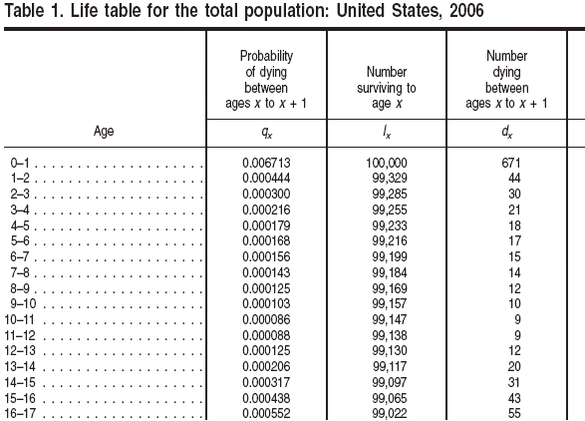
National Vital Statistics Reports Vol 58, No. 21, June 28,2010 (cdc.gov)

Slide 10
Likelihood Function
where δ_{i} is the indicator of death status.

Slide 11
Parameter estimation
Simplex algorithm is used to find the maximum of the loglikelihood function.

Slide 12
A working example
122 cancer patients with local disease underwent radiation therapy are enrolled.
39 death and 83 censored.
Mean age 58.56yrs, range 33.7-87.7
One risk factor: # of lesions (less than 2 or more than 2)

Slide 13
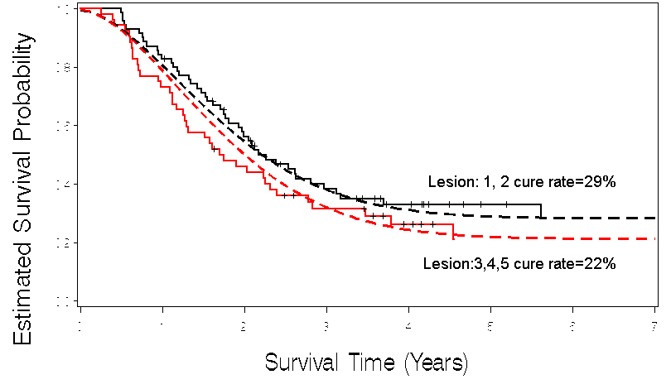
Survival Curve

Slide 14
Simulation
Use parameter estimated obtained from the example
Age distribution will follow the example
Sample size set at 100 and 150
Not finished yet.

Slide 15
Conclusion
The proposed definition of cure is closer to the reality
The proposed model may provide more accurate estimate of the cure rate
The proposed model may fit adult cancer population

Slide 16
Thank you

